Slide 1
ProcureAZ Tech Leads
Go Live role, Job aides and .....
the Kitchen sink

Slide 2
Today’s Agenda
Key Reminders
Tech Leads – Our Go Live Heroes
SPO Command Center
Steps to Prepared
Reference Materials to Support you in your Role
Wrap it up

Slide 3
Key Reminders
Spread the word / Plan accordingly

Slide 4
Key Reminders
ProcureAZ will become unavailable on same schedule as AFIS
System will go down evening of 6/30
Earliest Go Live is July 7, 2015
CanNOT begin entering documents for FY 2016 in ProcureAZ prior to Go Live
Upgrade to v12.5 must be complete before documents can be created
Will have to start all documents from scratch
Current ProcureAZ documents are ....Dead to You
You cannot clone those documents but can view after Go Live

Slide 5
Key Reminders
Approval Paths based on Accounting Segments must be updated after ProcureAZ conversion to v12.5
We will notify you if there is any way to complete that prior to 7/7
Use all ProcureAZ Credit Memos before June 30
Unused Credit Memos will not be converted
You will have to re-enter them in ProcureAZ after Go Live if you did not use them

Slide 6
Post Go Live System Schedule
AFIS availability 6 am – 8 pm
No ProcureAZ Documents can be integrated after 8p
AFIS to be up on weekends / holidays
ProcureAZ transactions can be integrated
No Help Desk / Support

Slide 7
Tech Leads
The agency focal point for go live

Slide 8
Tech Lead Role Focal Point for Agency Issues
First point of contact for Agency ProcureAZ Issues
Identify how the agency staff should funnel their questions to you
You need to communicate your strategy to your agency ProcureAZ users
If you are unable to resolve agency ProcureAZ issues then contact the appropriate help desk
Purchasing/Procurement staff contact SPO Help Desk
Accounting staff contact GAO per BREAZ instructions

Slide 9
Tech Lead Role During Go Live
Attend Go Live Status meetings
SPO Team will host the calls
Opportunity to share trends / issue resolution
Initial Frequency will be Daily
Will assess if we can reduce dependent upon issue volume / communication needs

Slide 10
Tech Lead Role During Go Live
Distribute Go Live communications to agency staff
SPO will issue Hot Topics (Hot Sheets) if necessary to document trends / issue resolution
Establish your outward communication channels
Tell us how we can support you better
Breathe Deep, Remain Calm, We will figure it out together!

Slide 11
SPO Command Center

Slide 12
SPO Go Live Command Center
SPO Training Room will be our Command Center
SPO Help Desk Team (4 staff) answers vendor calls and may have limited availability
Additional SPO staff will man the Command Center phones in shifts but numbers are limited
v12.5 SME will also be in the room to assist the attendants
Phone Coverage will be 7 am - 6 pm

Slide 13
Issue Reporting
If the Agency Tech Leads are unable to resolve the issue, call a State Help Desk
Do Not call Periscope Help Desk
Central Phone Number w/menu 602-542-7600 Opt 2
Hold for next Attendant or Leave message
SPO Help Desk Use GoToAssist to watch user system interactions /entry
Email Issue Reporting during Go Live: ProcureAZCentral@azdoa.gov
Issue Reporting Form Required
Bugs will be reported to Periscope by State Help Desk
SPO / BREAZ team will determine when Periscope needs to be engaged in issue resolution

Slide 14
Go Live Communications
Tech Leads
Attend Daily Checkpoint Calls during Go Live
Will assess frequency and adjust as needed
SPO Website Tech Leads page for Communications
Hot Sheets / Tips if trends are noted
General Communications
ProcureAZ Alerts
Email communication directly to users that have registered
ProcureAZ News Posting
Posting within ProcureAZ to provide link over to posted information

Slide 15
Preparation, Not Perspiration

Slide 16
Complete Training
Attend On / Off Contract Training at least once
Classes still available this week and next week
New Features in v12.5 Training
Listen to the recording if you have not attended
https://attendee.gotowebinar.com/register/6411070149577609730
Review the questions and answers from the sessions
Complete the Open (Hands-on) Lab Activities
Activities will be posted to the SPO website

Slide 17
Environment Availability
TRAIN remains available
Great place to PRACTICE transactions.
Use the Generic User IDs and can use the Training/Activity Lab Exercises
UAT
Has COA more recent than TRAIN
Also has the Generic User IDs
Both will Remain Available through Go Live

Slide 18
Materials that we Hope will Support You

Slide 19
Reference Materials
Review the “References on the SPO Website” Listing
Understand the Integration Methodology
Change Order Constraints
“Working as Designed” scenarios
Starter List of Error Messages
Invoice Review Aide

Slide 20
v12.5 Reference Listing
List of Topics
Links to SPO Website Locations
May benefit all your ProcureAZ Users

Slide 21
Integration Highlights

Slide 22
Integration by Document type
Notes:
COMMON
When Integrating
Checking COA existence
Confirming Sufficient funds
AFIS document code will contain PZ
Cannot edit documents interfaced from ProcureAZ to AFIS
Near Real-time integration – Payments TOO
PreEncumbrance
In all documents other than an RPA, the conversion of a ProcureAZ Requisition to a ProcureAZ Purchase Order will result in an AFIS integration. That successful integration will create a PreEncumbrance in AFIS.
Encumbrance
Sending a Purchase Order to the Vendor will trigger an integration to AFIS. For documents other than RPA, this integration will release the PreEncumbrance and create an Encumbrance in AFIS.
Encumbrance Modifications
Change orders that have financial impacts (adding items, changing accounting) will result in a Encumbrance modifications being sent to AFIS.
Payable
Final approval of a ProcureAZ Invoice will result in an integration to AFIS. That integration will release the Encumbrance and create the Payable in AFIS. Invoices interfaced individually – not summarized/batch
DIFFERENCE
PreEncumbrances
ProcureAZ Open Market Requisitions create a PreEncumbrance in AFIS. The ProcureAZ Open Market Requisition is the only ProcureAZ Requisition document that creates a PreEncumbrance. When the Open Market Requisition is converted to a Purchase Order, the original PreEncumbrance will be released and a new PreEncumbrance will be established on the Purchase Order.
The RPA document does not create a PreEncumbrance in AFIS. This is because an RPA is an after the fact purchase authorization and there is no need to PreEncumber funds.
PreEncumbrance Modifications
Open Market Purchase Orders and Standard Release Purchase Orders can be modified by the Basic Purchasing user before they are converted to a Purchase Order. Modifications that have financial impacts (adding items, changing accounting) will result in a PreEncumbrance modification being sent to AFIS.

Slide 23
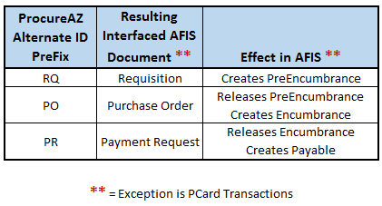
Alternate Id Content AFIS Document Numbers
Notes:
Regardless of the integration point, the methodology is the same. The ProcureAZ document will display a string in the Alternate ID Field. That string will include a prefix that identifies the AFIS document type.
> When the ProcureAZ Alternate ID field is prefixed by RQ, this indicates that a Requisition document has been created in AFIS and a corresponding PreEncumbrance has been established for that amount.
> An Alternate ID field prefixed by PO indicates that an AFIS Purchase Order has been created and that AFIS includes an Encumbrance for that amount. This further indicates that the PreEncumbrance was released before the Encumbrance was created.
> ProcureAZ Alternate IDs prefixed by PR indicate that an AFIS Payment Request was created. The AFIS Encumbrance will be released prior to the AFIS Payment request creation.

Slide 24
Integration
Interface to AFIS
Accounting Codes
Sufficient Funds
Alternate ID
Link to AFIS document
i
Notes:
Document is automatically interfaced to AFIS. If the accounting codes are legitimate and sufficient funds are available in the account to pay for the requested Items, the document should successfully interface to AFIS. Successful integration will create a pre-encumbrance in AFIS. The ProcureAZ document’s alternate ID field will display a string/value that begins with RQ for PreEncumbrance.

Slide 25
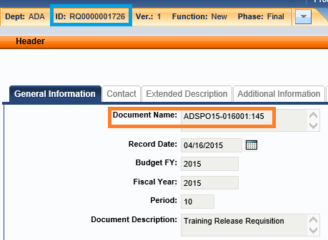
AFIS Integration
Document Successfully Established
Search for Alternate ID
Document Name field on General tab contains the ProcureAZ Document number
Notes:
Search for the RQ number in AFIS to locate the ProcureAZ Purchase Order that was interfaced to create an AFIS Requisition. This AFIS requisition will pre-encumber the total amount of the ProcureAZ PO.
The ProcureAZ Purchase Order number will be mapped to the AFIS Document Header’s Document Name field. This may assist the agency with back-tracking to the ProcureAZ document number if research begins in AFIS.

Slide 26
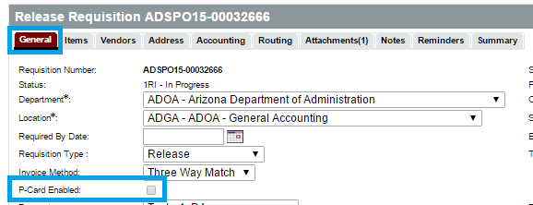
PCard Affects on Integration
No integration if PCard is used on the ProcureAZ document
Consult with your agency on PCard payment processing methodology
Notes:
When the agency selects the PCard as the payment method, there is NO INTEGRATION to AFIS. This is due to the State’s PCard payment methodology. The Alternate ID field may evidence a string, but a search for that document in AFIS will not yield any results. Consult with your agency to learn specific PCard payment processing steps for your Agency.

Slide 27
Change Orders

Slide 28
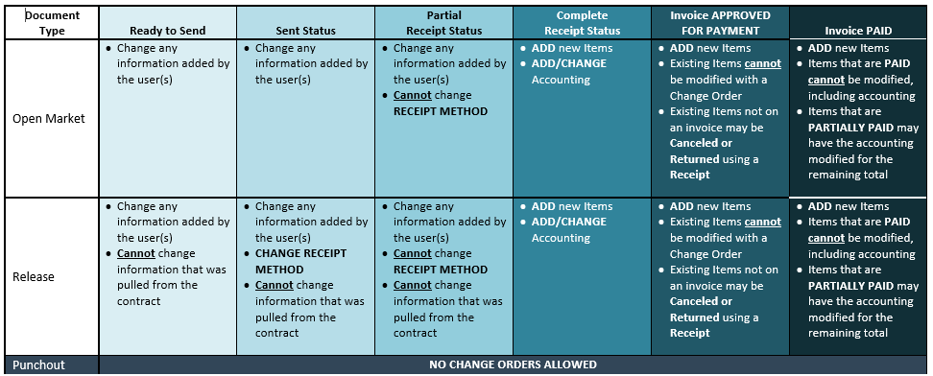
Change Order “Rules”

Slide 29
Working as Designed ;<)
Situations that your users may encounter

Slide 30
Situations Your Users may Present
FILE: Working as Designed Scenarios (Tech Leads Page)
Items that we have encountered that ‘could be’ considered errors but the system is working according to its current design.
Row 2 – User will not be able to see an AFIS error message when you return the Release Requisition for correction
Row 6 – COA error on RPA – Cannot correct – Cancel / Clone
Row 9 – Cloned PO does not contain the accounting
Row 16 – Cannot find Maximo PO Number in ProcureAZ – Note case when searching

Slide 31
Error Messages

Slide 32
AFIS Limitations on ProcureAZ Document Content
Thresholds will be in place
Maximum of 25 items
Maximum of 75 accounting lines
If EITHER are exceeded the document will be rejected by AFIS at the attempted integration
Examples of unsuccessful Docs
1 item w/ 76 accounting lines
25 items w/ 4 accounting lines each
Rejections of Punchouts will require the user to cancel and begin the item selection process all over – cannot edit Punchouts

Slide 33
Anatomy of an Accounting Error
ERROR : COMMGP=1,COMM=1,ACTG=2 :
COMM=1
Identifies which ITEM has the error
ACTG=2
Identifies which ACCOUNTING LINE on the item is evidencing the error
This will enable you to determine which COA needs to be reviewed

Slide 34
...the “rest” of the words
Fund is required; Unit is required; Appr Unit is required; Task is required
Object is required
Budget line not found for .....
The Current Fiscal Year, Department and Function does not exist on the Function Table.
Fiscal Year, Document Code and Object exist on the Invalid Document Code and Object Combination table
The Commodity does not exist on the Commodity Code Table

Slide 35
Error Message Compilation
FILE: ProcureAZ Error Message Starter List (Tech Leads Page)
Will need to continue to grow the list over time – 20+ entries
Worksheet outlines
ProcureAZ Document that displayed error
Source – ProcureAZ or AFIS generated message
System Error(s) – The error message
Cause – The reason we believe the error occurred
Resolution – Possible action to resolve the error

Slide 36
Error Message Examples
Row 2 – AFIS - System Down
Row 7 – ProcureAZ – COA Conditional Logic
Row 11 – ProcureAZ – Req/PO Accounting Tab Error
Row 19 – AFIS – Invoice Item Entry Error
Row 20 – AFIS – Invoice Payment for Remaining Quantity

Slide 37
ProcureAZ
DRAFT
Invoice – Item entry / Review Aid

Slide 38
Invoice Integration Challenges
Most Invoices do not include entire item order from PO
Most invoices for Items/Goods include Tax
Requires AP Clerk to successfully determine values
Invoice Amount – w/ Tax
Unit Cost - w/o Tax
Invoice entry error messages not known until AFTER final approval
Likely to impact Invoice Payment throughput
Notes:
Overview
Payments for goods and services received are recorded by Accounts Payable users in ProcureAZ using an Invoice document. After an Invoice has been created, submitted, and approved, the payment request is processed through an interface with AFIS to create a Payment Request document. Once the payment has been made, the result of that process is then interfaced back to ProcureAZ in order to record the payment. This lesson details the steps and new features involved in the creation, submission, and processing of an Invoice as well as the Invoice search methods and Credit Memo application process.

Slide 39
Role that it Could Play
Adoption by Supervisors
Tool for AP Supervisor to provide course correction to staff
Increase Invoice Entry Understanding
Adoption by AP Clerks
Build/Reinforce process for determining Invoice field amounts for situations other than payment equal to full PO order
Reduce Errors to maintain agency throughput
Morale Boost

Slide 40
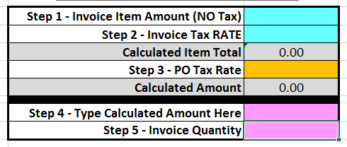
Automatic Calculation -->

Slide 41
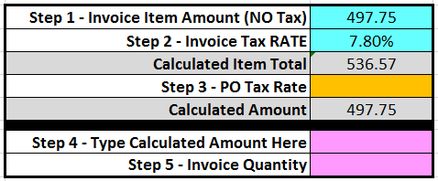
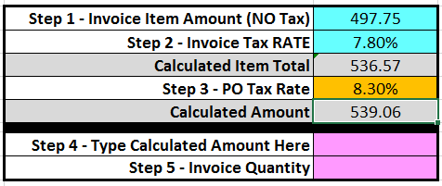
Automatic Calculation-->

Slide 43
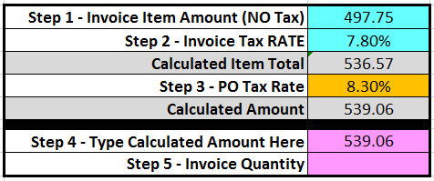
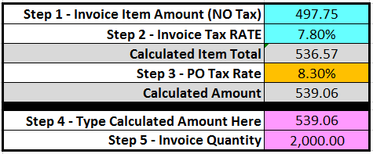
Type Invoice Quantity Here->

Slide 44
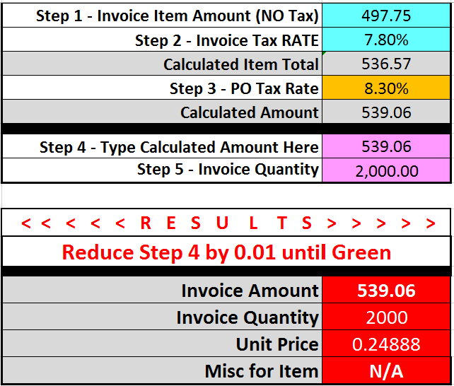
Cross Check indicates that these values will cause an error in AFIS

Slide 45
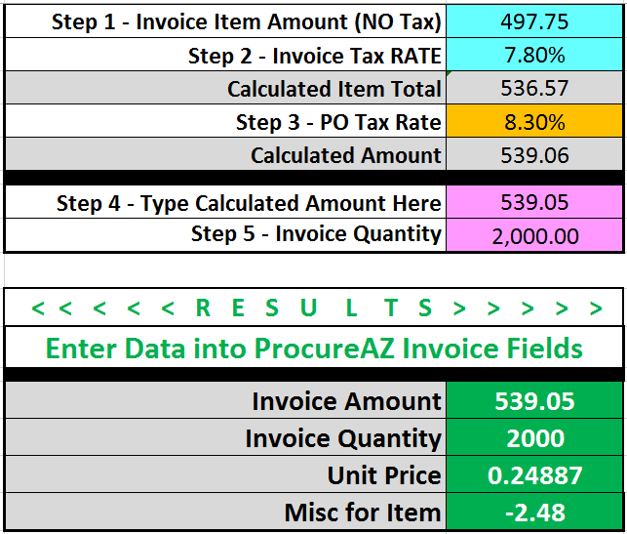
Reduced by .01 ->
Cross-check Indicates the reduced amount will integrate to AFIS

Slide 46
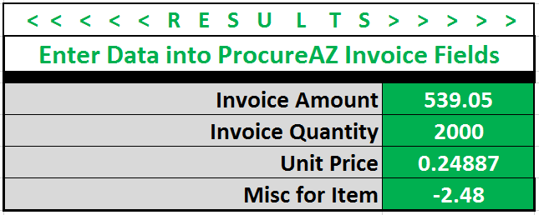
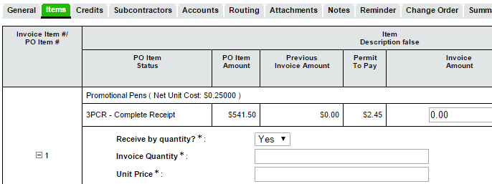

Slide 48
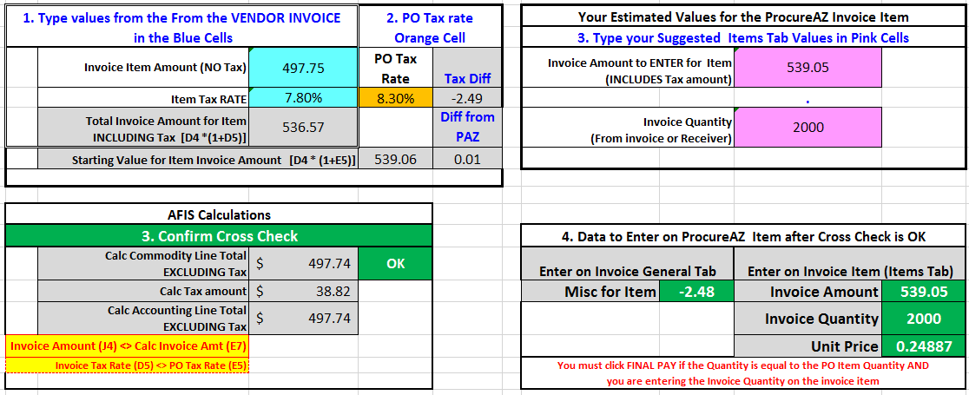
Detailed Worksheet for Review by AP Supervisor if Desired

Slide 49
Invoice Item Entry/Review Tool Needed or Hype?
If Yes
Who is best audience?
How do we further hone it?
What additional support is needed?

Slide 50
Back to Error Message
Row 20 – AFIS – Invoice Payment for Remaining Quantity

Slide 51
Need Practice Exercises for AP Staff ?
Clone PO in TRAIN environment / Receive
7 activities
Simple Invoice
Search for/Locate Your Invoice
Create Credit Memo
Adjust Payment terms/Payment date & Add Credit memo
Process a Receive by Dollars invoice Item & Add Use Tax
Add Freight to Invoice
Add Accounting Change order & see Object Inference
If you want this, email Elli.Balstad@azdoa.gov

Slide 52
Wrap it Up

Slide 53
BREAZ Training Room Location for Walk-in Help
SPO Training room being used for Go Live Command Center
BREAZ kind enough to offer their Training Room for scheduled “Help Sessions”
Will you pick up your documents and
drive over to BREAZ to obtain SME assistance?

Slide 54
Request for Volunteers
Agencies to execute (real) transactions in PROD ProcureAZ to assist with shakedown testing post conversion/Prior to go live

Slide 55
Additional Support...
Let us know what we can do to help you be successful

Slide 56
ProcureAZ Go Live Issue Reporting
Contact Your Agency Tech Lead
<<NAME> <Contact Info>
If the Tech Lead Cannot Resolve the Issue
Phone: 602-542-7600 Option 2
Email: ProcureAZCentral@azdoa.gov
Must attach Issue Reporting Form

