Slide 1
ProcureAZ
11 Invoices

Slide 2
Objectives
Review how to locate a Purchase Order for payment
Create an Invoice to request a payment
Review how to locate Invoices in ProcureAZ
Create a Credit Memo
Notes:
Overview
Payments for goods and services received are recorded by Accounts Payable users in ProcureAZ using an Invoice document. After an Invoice has been created, submitted, and approved, the payment request is processed through an interface with AFIS to create a Payment Request document. Once the payment has been made, the result of that process is then interfaced back to ProcureAZ in order to record the payment. This lesson details the steps and new features involved in the creation, submission, and processing of an Invoice as well as the Invoice search methods and Credit Memo application process.

Slide 3
Locate a Purchase Order
Advanced Search
Purchase Orders
Search Criteria
Documents Menu
Invoice
New
Search PO
PO Number
Header Major Status
Partial Receipt
Complete Receipt
Notes:
Invoices can be created by users with the Accounts Payable role to request payment for goods or services on a Purchase Order. Invoices can only be submitted for Purchase Orders that contain Items that have been partially or completely received and where the Permit to Pay amount is greater than or equal to the amount to be entered on the Invoice. The Invoice creation process can begin several ways, which include the following commonly used methods:
The Advanced Search feature can be used to locate Purchase Orders that have a status of Partial Receipt or Complete Receipt.
The Documents menu can be used to create a new Invoice by selecting Invoice > New. This will display a search page that can be used to locate and select a Purchase Order for payment.

Slide 4
Create an Invoice
General Tab
Items Tab
Credits Tab
Accounts Tab
Attachments
Reminders
Change Orders
Review and Submit
AFIS Integration
Disbursements
Notes:
After completing the steps in the Locate Purchase order section, the Invoice will be open on the General tab. As with other ProcureAZ documents, completion of an Invoice should proceed through the tabs on the header of the document from left to right. The subcontractors tab will not be used and can be ignored.
TIP: If an in progress Invoice exists for the PO with an Invoice Change Order, users cannot create another Invoice until the Invoice with the Change Order is approved or canceled.

Slide 5
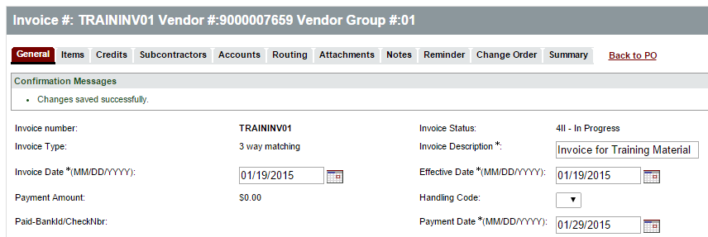
General Tab
New
Invoice Number
Invoice Description
Dates
Invoice Date
Payment Date
Effective Date
Notes:
Invoice numbers can be reused if an invoice is cancelled
Invoice Date and payment Date will be interfaced to AFIS – Effective date is not interfaced
TIP: To generate a same-day payment, enter the current date in the Payment Date field.
TIP: An Accounts Payable best practice is to ensure that payments are made during the vendor discount period to take advantage of any applicable discounts.

Slide 6
General Tab
New
New
Edit Payment Terms
Use Tax
Calculated by AP user
Notes:
Vendors may offer payment terms as part of their contract. Those terms are automatically placed on the invoice general tab. If the vendor is providing different payment terms for this invoice, the AP user can click EDIT to select the new payment terms. Expectation would be that the terms are being changed for the better during this exercise – always check with your agency for their policy on this process.
If the use tax has not already been entered on the items, ProcureAZ allows Accounts Payable users to enter Use Tax during Invoice creation. This allows the specified amount to be identified as Use Tax, rather than as a Miscellaneous amount on the Invoice. Selecting Yes for “Is Use Tax required and not already on the PO?” provides the ability to enter the Use Tax amount on the accounting lines for each Item on the Invoice.

Slide 7
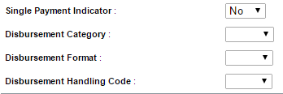
General Tab
New
Disbursement Options
Single Payment Indicator
Disbursement Category
Disbursement Format
Notes:
There are several payment options available in AFIS that are also included on the General tab of an Invoice in ProcureAZ. When selected, these options will be interfaced to AFIS when the Invoice is successfully submitted.
Single Payment; Default is NO. Normal GAO practice is to combine all payments to one vendor on a particular day. If the vendor requested this payment remain separate, select YES from the Single payment indicator drop-down
Disbursement Category: GAO distributes/mails the warrants to the vendor. If the Vendor needs to pick-up the warrant, select PULL from the drop-down. The agency will have to go to GAO to pickup the warrant and then make arrangements with the vendor.
Disbursement Format: The default vendor payment method is maintained in AFIS. If the vendor normally receives an EFT/ACH payment and is requesting a warrant for this payment, select WAR from the Disbursement Format drop-down.
Disbursement Handling Code: Not currently being used / May be in the future.

Slide 8
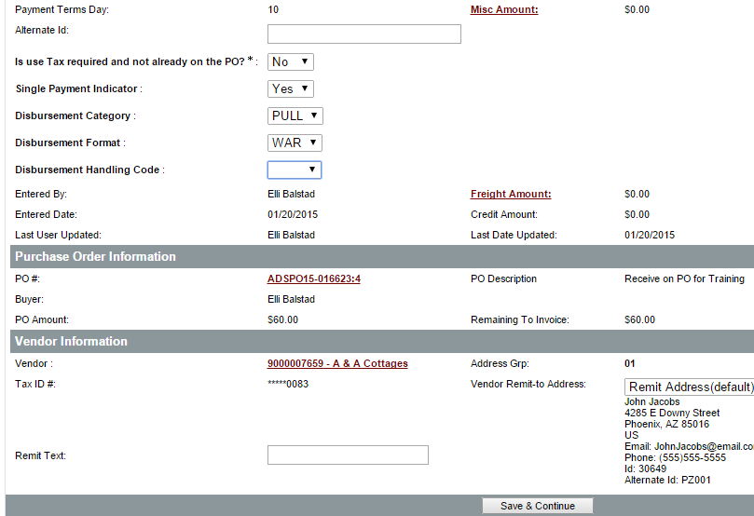
General Tab
Miscellaneous amounts
Freight amounts
Purchase Order Information
Vendor Information
Save and Continue
Notes:
Misc and Freight fields do not appear until the invoice has been saved for the first time.
TIP: The Freight and Misc fields should not be used as a substitute for a Change Order. GAO expects amounts entered into Misc and Freight on the invoice header to be nominal.
TIP: ProcureAZ allows the setup of approval paths based on misc/freight amounts entered on an invoice header. Agencies should implement this type of approval path to require the review of miscellaneous and freight charges on an Invoice when they exceed pre-defined agency thresholds.

Slide 9
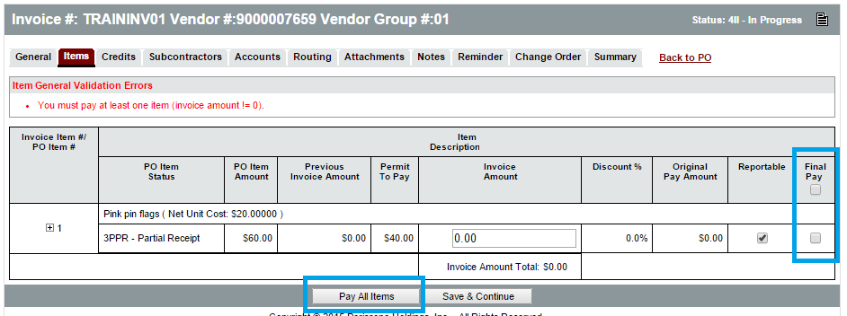
Items Tab
Pay All Items
Final Pay
Notes:
The Items tab displays all of the Items on the Purchase Order, along with columns for their PO Item Status, PO Item Amount, Previous Invoice Amount, Permit to Pay amount, and the Discount percentage.
TIP: Clicking Final Pay on the item will close out the item. In addition, if the total paid is less than the encumbrance, Final Pay will generate a change order to the ProcureAZ PO. When the final pay is integrated to AFIS it will release the encumbrance and return the amount to the agency budget in AFIS.

Slide 10
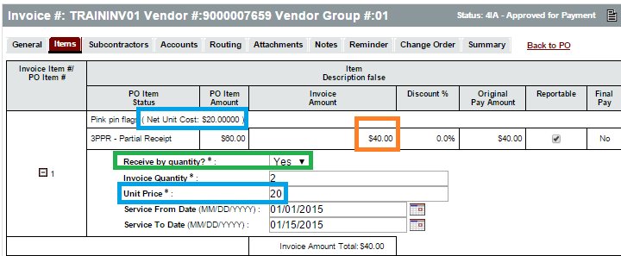
Items Tab
Collect Invoice Data for AFIS
Receive by Quantity
Invoice Quantity
Unit Price
New
Notes:
Additional information must be entered on the invoice for non-service items. AFIS needs to receive the Quantity and the Unit Price for the non-service items as part of the integrated information.
Select Yes from Receive by Quantity drop-down
Enter Quantity that is being paid as part of this invoice. CRITICAL: this quantity will determine the number of Fixed Asset shells created for Stewardship/Capital items so it is important to enter the correct quantity.
Unit price should be the NET unit price incorporating all item discounts. Tax is EXCLUDED From this amount. The Item’s Net Unit Cost is displayed after the item description.
TIP: AFIS considers any NIGP codes that are not 900 series to be non-service Items.
TIP: More detailed information on the completion of the Invoice Quantity and Unit price fields can be found in Appendix B - Enhancements Overview within the ‘Collect Invoice Data Required to interface Goods to the New AFIS PRC Document’ topic.

Slide 11
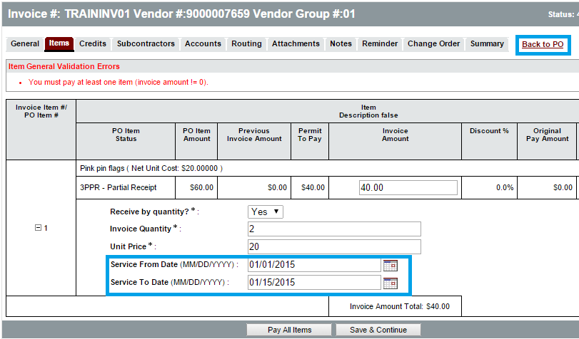
Items Tab
Service Dates
Service From Date
Service To Date
New
Notes:
Service From/To dates will be interfaced to AFIS.
TIP: If Service From/To Dates are not provided on invoice items, the AFIS fields will default to the current system date.
These fields are also available/may’ve been completed when the receipt was created. If you wish to review the Receipt, right click back to PO and open in a new tab to review the Receipt information.
These dates may be used by your agency to influence the grant funds that are utilized to pay for the goods/services on this invoice.
TIP: More detailed information on the completion of the Service From/To Date fields can be found in Appendix B - Enhancements Overview within the ‘Allow Entry of Service From / To Dates’ topic.

Slide 12
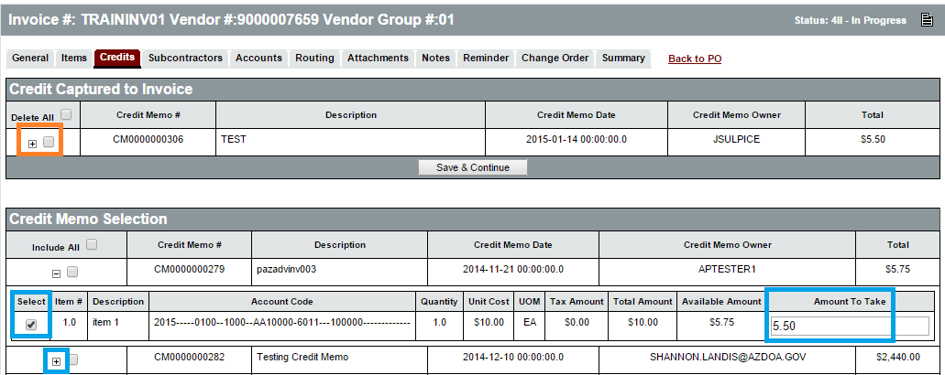
Credits Tab
Add Credit Memo
Don’t have to use entire credit memo amount on this invoice
Delete Applied Credit Memo
Notes:
Add Credit memo:
Click the Plus next to the credit memo to display the COA and available amount. Type a lower amount in the Amount to Take field if you do not wish to use the entire credit memo on this invoice. Click Select box, Click Save & Continue
TIP: The Credit Memo amount applied to an Invoice must be less than the Payment Amount on the Invoice. AFIS cannot issue a $0 payment.
Delete Credit Memo added tot his invoice
Click the Delete box on the desired item within the Credit Captured to Invoice section – click Save & continue

Slide 13
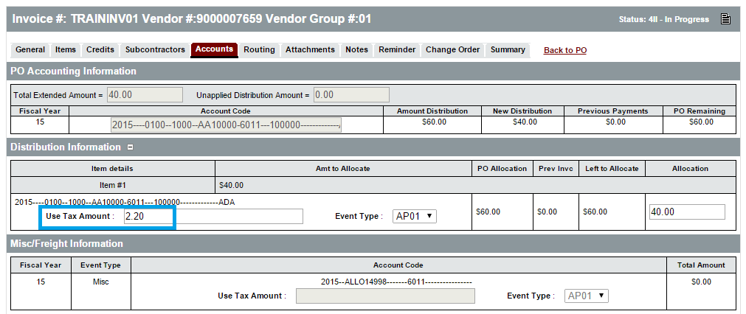
Accounts Tab
Disbursement Information
Enter Use Tax amount on items
Miscellaneous/Freight Information
Credit Memo Information
Notes:
Most of the time this tab is just ‘reviewed’ vs. any data entry.
If you have answered YES to ‘Is use Tax required and not on PO’ then you just visit the accounts tab to identify the amount of the use tax and which items/account it belongs on.
Click the + after Distribution information to display the item accounting and fields to enter use tax. AP must calculate the amount of use tax and enter it on each desired item’s accounting lines.
If the COA on the items needs to be changed, that cannont be done on this tab. A change order would have to be processed in order to accomplish the item accounting changes.

Slide 14
Attachments
Add File
Attachment Management
Notes:
Agencies can scan hard copy invoices and attach them to the ProcureAZ invoice if the vendor sent a paper invoice.

Slide 15
Notes
Add Notes
Header
Item
Notes:
The Header > Notes tab is used to add notes about the invoice document that are only visible to Organization users who access the document. Notes are entered in the Note field, which allows multiple lines of text to be entered. When one note is entered, clicking the Save & Continue button will save the note and add a new blank Note field for another note. Any notes that are saved to the document are stamped with the date they were added. Checking the Delete check box and clicking the Save & Continue button will remove the note from the document. The reset button will revert any changes made to the notes since the document was last saved. Like Attachments, the number of Notes added to the document will display in the tab name in the Header > Notes tab.

Slide 16
Reminders
Create a Reminder
Due Date
Comment
Remind Whom
Days Prior to Remind
Modify and Delete Reminders
My Reminders
Notes:
It may be necessary to create reminders on the Invoice that will notify other users on a specified date that an action is required on their part. For example, if the Invoice cannot be completed because there is not yet a complete Receipt and an approved amount for payment, a reminder can be sent to the appropriate Department reminding them to complete the Receipt. More than one reminder can be added to an Invoice. Any reminders currently assigned to a user will be displayed on the My Reminders tab on the user’s Home Page.

Slide 17
Change Order Tab
Request a Change to PO Accounting
Notes:
If the accounting information on the Purchase Order needs to be changed to make this payment, an Invoice Change Order can be created on the Change Order tab of the Invoice. Invoice Change Orders can only modify the account codes and distribution for the Items on the Purchase Order. Changes cannot be made to Invoices that have already been paid.
Click the item number to display the COA fields to edit the accounting.
Submitting the Invoice will route the Change Order for approval. Once the Change Order has been approved, the Invoice can be processed.

Slide 18
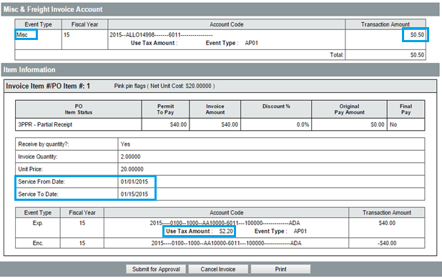
Review Summary Tab
Misc / Freight Amts
Service Dates
Use Tax Amts
Notes:
Reviewing the Summary tab is your opportunity to catch mistakes that may’ve been made
Did you enter accounting for a Misc/Freight but forget to place the amount on the far right end of the COA entry?
Have you entered the use tax amounts on the items in the Distribution section if you entered “YES’ to the use tax required question.
Did you enter the correct Service Dates (if applicable0
TIP: If there are available Credit Memos that could be applied to the Invoice, a general validation warning message will be displayed at the top of the Summary tab.

Slide 19
Submit
Submit Invoice
Approval Path
Misc/Freight Threshold Review
Notes:
Submit the Invoice
If the agency has implemented the recommended Misc/Freight Approval path, and the amounts meet the threshold, ProcureAZ will display dialogue letting AP know the path has been triggered.
If that path is triggered, the invoice must be approved on that path before it will be provided to the AP Supervisor for final approval

Slide 20
Routing
Approval Paths for this document
Approvals displayed as they are encountered.
Misc/Freight path displayed
Notes:
The Routing tab will list the approval paths that apply to the invoice after it has travelled the path.

Slide 21
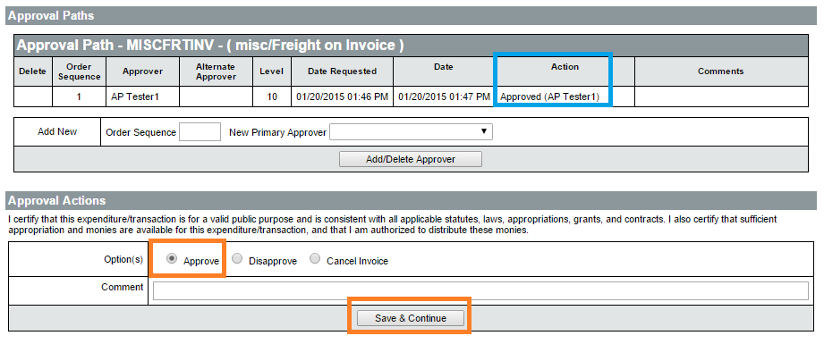
Final Approval
AP Supervisor
Approve for Payment if Appropriate
i
Notes:
The invoice will be routed to the AP Supervisor for final approval after the document has been approved on all associated approval paths.
After final approval, invoice will be integrated to AFIS. If the accounting codes are legitimate and sufficient funds are available in the account to pay for the requested Items, the document should successfully interface to AFIS. If the approved invoice interfaces successfully, a payment request is created in AFIS. The ProcureAZ Invoice’s alternate ID field will display a string/value that begins with PR.

Slide 22
AFIS Integration ProcureAZ Invoice
Invoice creates Payment Request (PRC) in AFIS
Alternate ID in ProcureAZ links to AFIS Document
Notes:
The interfaced Invoice document from ProcureAZ is used to create the Payment Request (PRC) document in AFIS that generates the payment. Invoices that have been approved for payment in ProcureAZ are interfaced to AFIS after the final approval. If the Invoice interface is unsuccessful, AFIS will provide a message to ProcureAZ.

Slide 23
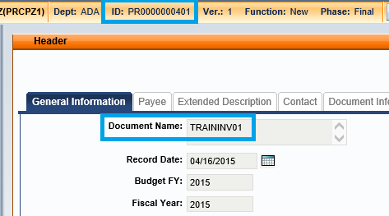
AFIS Integration ProcureAZ Invoice
Search for Alt ID in AFIS
ProcureAZ invoice# displayed in Document Name Field

Slide 24
ProcureAZ Invoice Cancellation
New
AP Supervisor Cancel Invoice after AFIS Integration
Only if Payment is not yet disbursed
Notes:
The AP supervisor will have a Cancel Invoice button on the invoice.
The AP supervisor can cancel the invoice until the Warrant has been generated/interfaced to ProcureAZ during the nightly cycle.

Slide 25
ProcureAZ Invoice Cancellation
New
Can Reuse invoice number in ProcureAZ after cancellation
Notes:
ProcureAZ will now allow the agency to re-use the cancelled invoice number for the new invoice.
Invoice numbers must still be unique across ProcureAZ.
Above, TRAININV01 was cancelled because a data entry error was discovered and a new TRAININV01 was entered

Slide 26
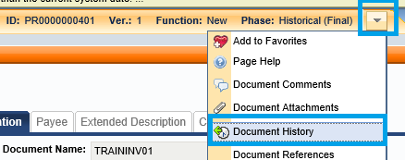
AFIS Integration Invoice Cancellation
Invoice Zeroed out in AFIS
View Document History
Notes:
Cancelling the invoice zeros it out in AFIS and results in a new version of the existing invoice document.
To review it you still use the ProcureAZ Alternate ID to find the AFIS document.
Click arrow beside Phase to select Document History.
This will display the list of versions for the current document.

Slide 27
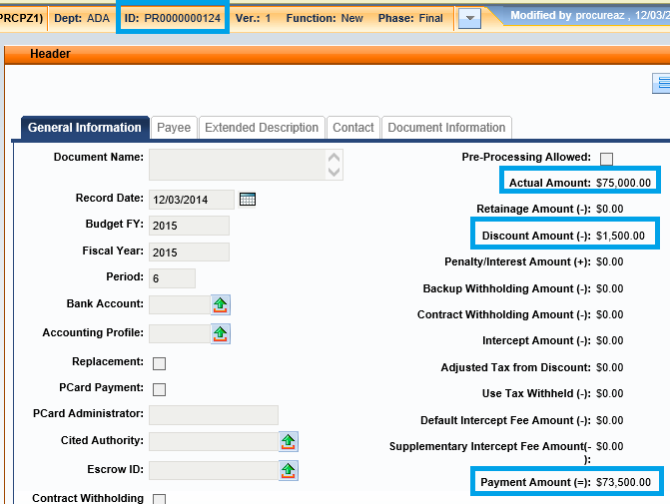
AFIS Initiated Disbursements
AFIS runs Disbursement (batch) Job nightly cycle
Pays net of any discounts/credit memos
Payment information interfaced back to ProcureAZ based on AFIS Doc ID
i
Notes:
The AFIS nightly cycle includes jobs to generate disbursements for all Payment Request Documents that have today’s date.
Payments are net of any vendor discounts and/or credit memos.
AFIS users can perform forward reference from AFIS PRC to the AD document to see the check/EFT information
After the disbursements are generated, a warrant post-back file is processed (nightly batch) into ProcureAZ.

Slide 28
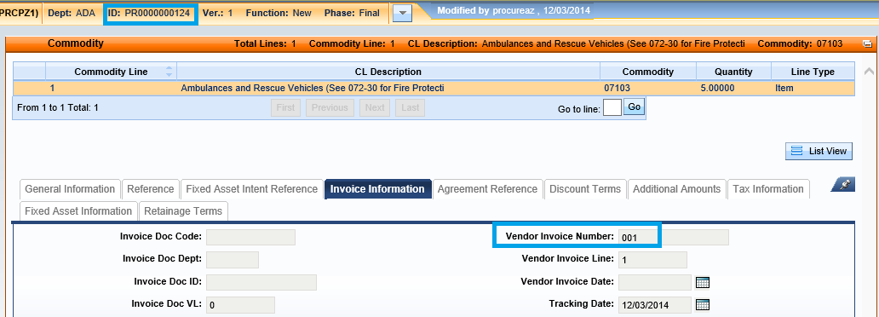
AFIS Disbursement Integration Track Back to ProcureAZ
ProcureAZ Invoice Number is on AFIS commodity > Invoice Info Tab
AFIS Doc ID is ProcureAZ Invoice Alternate ID

Slide 29
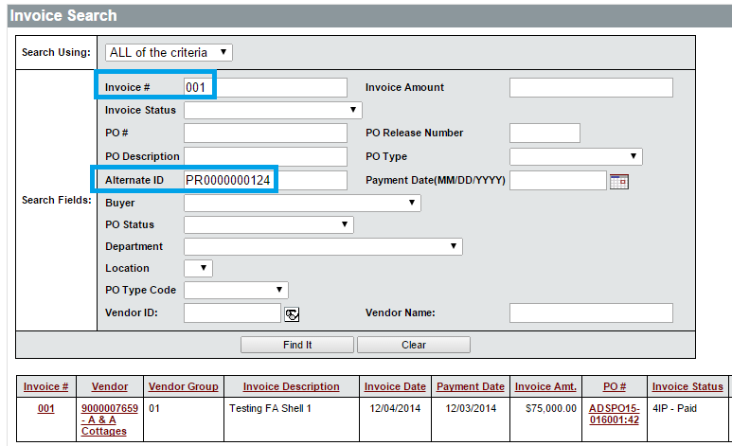
Locate Paid ProcureAZ Invoice
Search for invoice by AFIS Document ID (Alternate ID) and/or Invoice#
Notes:
To move from AFIS back to ProcureAZ, you can search Invoices by ProcureAZ invoice number (from AFIS invoice information tab) and/or the AFIS Document ID – which is the Invoice Alternate ID in ProcureAZ
If you only search by invoice number, you may get multiple results. For example, searching for invoice 001 in ProcureAZ would bring up results for: 001, 001A, ABC001, Inv001ABC
Click the Invoice Number in the results table to view the invoice.

Slide 30
ProcureAZ Paid Invoice
Status is Paid
Check Number is recorded
Notes:
ProcureAZ invoices that were paid will display a status of Paid.
The invoice will display a the disbursement number from AFIS (AFIS AD Document id)

Slide 31
ProcureAZ Paid Invoice Payment Amount
Click View More to see payment vs. total discount
Notes:
Clicking the View More link by the Paid-Bank/Check field (orange rectangle above) will provide you with summarized information about the payment. For this invoice, the agency paid $73,500 due to the $1,500 prompt payment discount.
These amounts are the NET amount – you are not going to see a breakdown of discount taken vs. credit memo taken on the View More screen.

Slide 32
Activity 11.1
Create an Invoice
Scenario
You have received notification that a Receipt has been approved for a Purchase Order and need to create an Invoice to request a payment to the vendor. You will locate the Purchase Order and then create the Invoice for the received Items.
Notes:
No approval action is required.

Slide 33
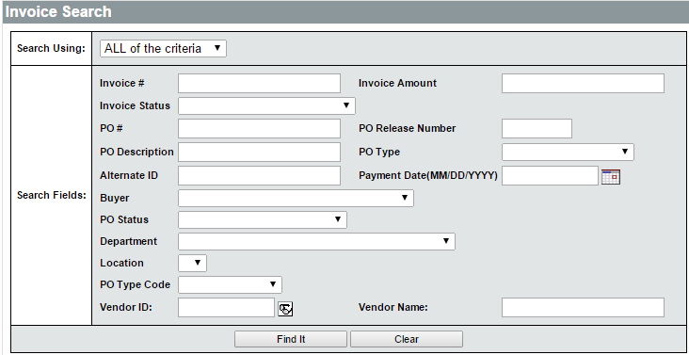
Invoice Search
Invoice Search Page
Invoice Number / Status /Amount
PO # / Description / Status / Type
Department / Location
Vendor ID / Name
Search Results Links
Invoice/Vendor/PO #

Slide 34
Activity 11.2
Search for an Invoice
Scenario
You need to locate and review the status of the Invoice you created in the previous activity. You will use the Invoice Search feature to search for the document.

Slide 35
Credit Memos
General Tab
Items Tab
Vendor/Address Tabs
Accounting Tab
Attachments
Reminders
Review and Submit
Notes:
Credit Memo documents are used to record a credit that has been offered by a vendor for use on a future Invoice. For example, if a payment has been sent to a vendor and the PO has been closed, the PO cannot be reopened in order to return Items or cancel an Invoice. In this case, the vendor may provide a Credit Memo that can be applied against future Invoices.

Slide 36
General Tab
New
Vendor Credit Memo Number
Description
Vendor/PO Number Selection
Department/Location
Credit Memo Date
Fiscal Year
New
Notes:
The Vendor Credit Memo number can be entered on the credit memo.
Credit memo entry can be streamlined by either selecting a vendor and then selecting a purchase order number associated with that vendor, or directly entering a Purchase Order number.
Make sure to examine the Fiscal Year field to ensure that the Credit Memo reflects the appropriate Fiscal Year.

Slide 37
Items Tab
New
PO Number Selected
Reason
Quantity
No PO Number Selected
Item Description
Reason
Quantity
Unit Cost/Unit of Measure
Notes:
If a PO Number is selected on the General tab, the Items > General tab will not display fields for user entry by default. Click the Add Items from PO button to select Items from the PO.
A new window will be displayed where users can select the Item to reference on the Credit Memo. The Item Description, Quantity, and Cost are shown on the PO Items page. Once the Items have been selected, click the Save & Exit button to return to the Items tab of the Credit Memo.

Slide 38
Vendor/Address Tabs
Vendor Tab
No user input required
Address Tab
No user input required

Slide 39
Accounting Tab
Accounting that is on the item selected on the PO will automatically transfer to the ITEMS accounting tab. NO ACTION REQD

Slide 40
Accounting Tab – Only if Manually Adding Items
Budget Fiscal Year
+
Accounting Template
OR
Function
Budget Fiscal Year
Unit
Fund
Appr Unit
Task
Notes:
TIP: These are the minimum requirements enforced by ProcureAZ. However, the fields required by AFIS vary dependent upon the Agency’s accounting methodology.

Slide 41
Object Code Inference Only if Manually Adding Items
New
Based on GAO Reference Table
Item NIGP Code
Dollar Amount
Object Code only inferred if left blank
Users can enter manually or override
Notes:
TIP: Users should refer to their agency’s policy regarding Object code usage. Users should enter an Object code if their agency has special expectations or usage for it.
TIP: The Object code is only inferred if left blank. If an Object code has been entered by the user before saving/applying the accounting to the item, ProcureAZ will not overwrite the Object based on the NIGP code.

Slide 42
Attachments
Add File
Attachment Management
Notes:
Any supporting documents for the credit memo can be scanned and attached to the ProcureAZ invoice as specified by policy and/or agency procedures.
It is important that any attached document name accurately describes the document.

Slide 43
Notes
Add Notes
Header
Item
Notes:
The Header > Notes tab is used to add notes about the Credit Memo that are only visible to Organization users who access the document. Notes are entered in the Note field, which allows multiple lines of text to be entered. When one note is entered, clicking the Save & Continue button will save the note and add a new blank Note field for another note. Any notes that are saved to the document are stamped with the date they were added. Checking the Delete check box and clicking the Save & Continue button will remove the note from the document. The reset button will revert any changes made to the notes since the document was last saved. Like Attachments, the number of Notes added to the document will display in the tab name in the Header > Notes tab.

Slide 44
Reminders
Create a Reminder
Due Date
Comment
Remind Whom
Days Prior to Remind
Modify and Delete Reminders
My Reminders

Slide 45
Review and Submit
Summary Tab
Yellow Warning Messages
Red Error Messages
Submit for Approval
Cancel Credit Memo
Clone Credit Memo
Available to related Invoices
Notes:
If the agency has an defined approval paths on the credit memo, those will have to be passed before the Credit Memo becomes available for use in ProcureAZ
Credit memos lives only in ProcureAZ until it is added to an invoice that is approved for Payment. The credit memo amount will then be interfaced to AFIS as a negative amount as part of the invoice.

Slide 46
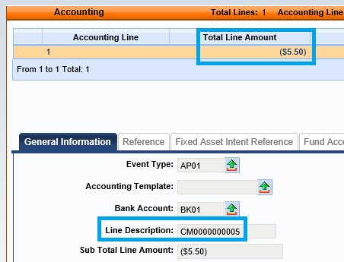
Credit Memo Integration to AFIS PRC
Commodity w/Type = Service
Negative amount
Vendor CM# placed on Accounting Line Description
Accounting Lines/amts based on CM info
Notes:
The CM interface will create a negative commodity line and under that there can be multiple accounting lines, each with negative amount (for each referenced CM line on the PAZ invoice). The commodity lien number will be 996 and commodity code will be 99999. The event type will be assigned in Advantage when the document is validated/submitted.
The commodity line will be for Lien Type of Service and with the contract amount (no quantity or unit cost).
The CM commodity or accounting lines in Advantage will be non-referencing.
The account elements for each PRC accounting line will be from the referenced CM accounting line of the PAZ invoice.
The accounting line description in Advantage will include the Vendor Credit Memo # from PAZ.

Slide 47
Activity 11.3
Create Credit Memo
Scenario
You have received a request to create a Credit Memo for Items that were returned to the Vendor after payment was sent. The vendor sent you a document that shows the Items and amount of the credit.

Slide 48
Summary
Reviewed how to locate a Purchase Order for payment
Created an Invoice to request a payment
Reviewed how to locate Invoices in ProcureAZ
Created a Credit Memo

Slide 49
Check Your Progress
Invoices can be created for Purchase Orders with what current status?
a. Partial Receipt
b. Complete Receipt
c. Closed
d. Both a and b
Notes:
The correct answer is d. Both a and b (Partial Receipt and Complete Receipt).

Slide 50
Check Your Progress
In order to create an Invoice, a Purchase Order must have an amount that has been approved for payment.
a. True
b. False
Notes:
The correct answer is a. True.

Slide 51
Check Your Progress
What is used to modify the accounting information on an Invoice?
a. New Purchase Order
b. New Invoice
c. New Change Order
d. New Item
Notes:
The correct answer is c. New Change Order.

Slide 52
Check Your Progress
When are payments scheduled to be processed by AFIS?
a. Weekly
b. Monthly
c. Nightly
d. Yearly
Notes:
The correct answer is c. Nightly

Slide 53
Check Your Progress
When creating a Credit Memo, what field can be used to allow the selection of existing Items?
a. Vendor Credit Memo number
b. Description
c. Department
d. Purchase Order Number
Notes:
The correct answer is d. Purchase Order Number.

