Slide 1
ProcureAZ
3 Punchout

Slide 2
Objectives
Create a Punchout Requisition
Check the status of a Punchout Requisition and correct/cancel a Returned Requisition
Review the Punchout Purchase Order process
Notes:
Overview
ProcureAZ allows users to purchase goods directly from the website of certain vendors that have contracts established with the State. The punchout integration between ProcureAZ and external vendor websites is used to browse and select Items which are then added to the Punchout Requisition document.
This lesson introduces the on-contract punchout ordering process in ProcureAZ. This process begins with the creation of a Punchout Requisition which is a type of Release. Following the submission of a Punchout Requisition, a Punchout Purchase Order is created. This lesson also reviews the document cancellation process. In the activities, users will gain work-applicable experience in the ProcureAZ training environment by navigating and creating the various documents in the Punchout lifecycle.

Slide 3
Create an Punchout Requisition
Shopping Cart Integration
Adding Items
Check Out
General Tab
Items, Vendors, and Address Tabs
Accounting Information
Attachments
Notes
Reminders
Review and Submit
Notes:
On-contract ordering through a Punchout Requisition involves: selecting a vendor, selecting the Items from the vendor’s website, completing the Requisition, and then submitting Requisition for approval. The Punchout ordering process in ProcureAZ provides several benefits:
Ensures that organizations always get the correct and most recent pricing on Items under contract
Allows the State to track all spending with each contractor and on particular Items which helps the State negotiate contract prices in the future
Provides the convenience of using online shopping websites while remaining in compliance with ProcureAZ’s automated approval routing process

Slide 4
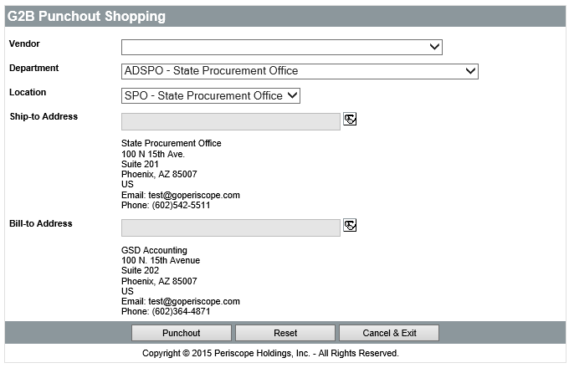
Shopping Cart Integration
Shopping Cart
Vendor
Department
Location
Ship-to Address
Bill-to Address
Notes:
TIP: Users must have their pop-up blockers turned off in order to successfully use the Punchout ordering process.
TIP: The information on the G2B Punchout Shopping screen cannot be changed once the Punchout process has begun by navigating to the vendor’s website. It is important to verify the information on this screen before continuing the process.

Slide 5
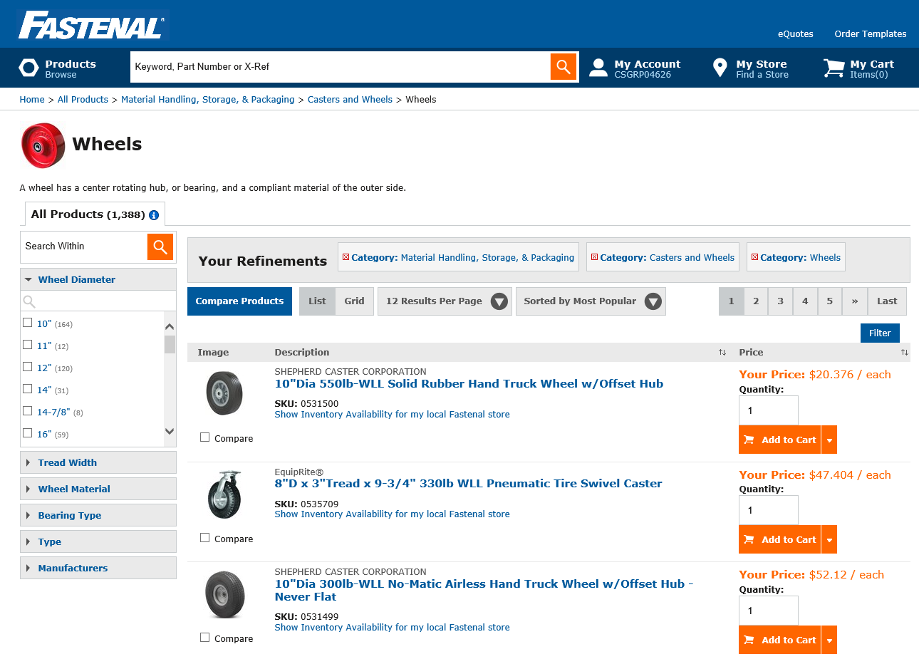
Adding Items
Using vendor website
Contract pricing
Browse items by category
Search by keyword or part number
Shopping cart to manage quantities

Slide 6
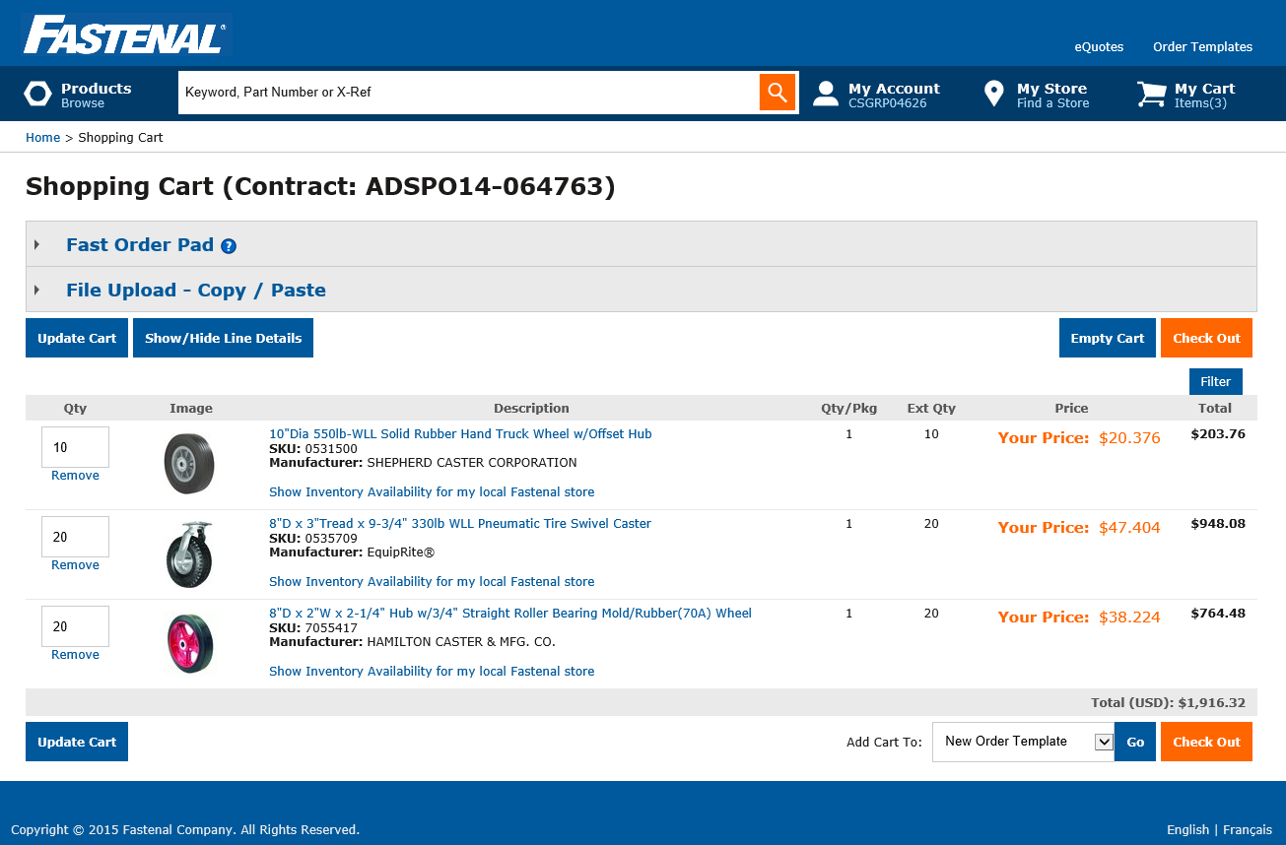
Check Out
Cart check out
Return to Requisition
Items added

Slide 7
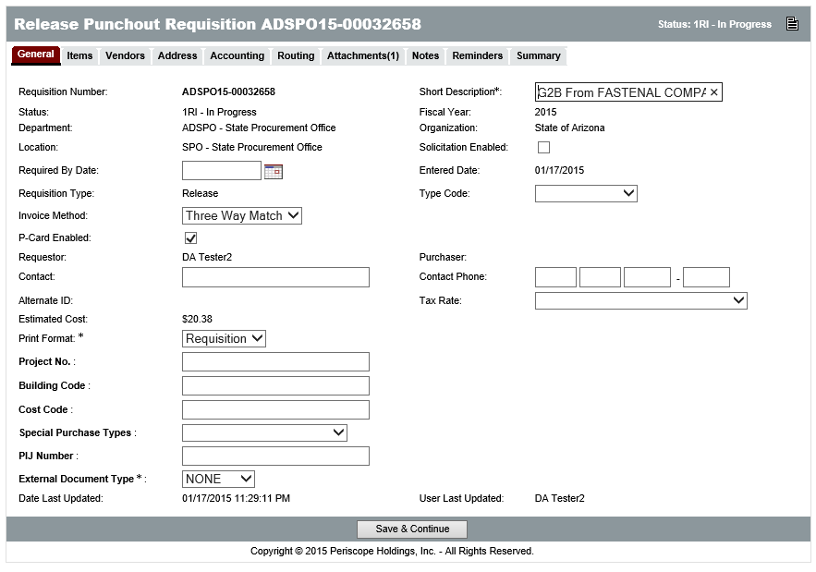
General Tab
Short Description
Requisition Type
Release
Invoice Method
Three-Way Match
Two-Way Match
P-Card Enabled
New
Notes:
The Invoice Method field on the General tab is used to select whether Two Way or Three Way Match will be used for the Requisition/Purchase Order. Two Way Match is a new option in ProcureAZ that requires a Purchase Order but does not require a Receipt to be entered before an Invoice can be processed. Selecting Three Way Match means that both a Purchase Order and a Receipt are required before an Invoice can be submitted. Three Way Match is the default Invoice Method and requires that the full documentation trail be created for a purchase.
TIP: Two Way Match is a role granted to specific users by their agency. If users do not have the Two Way Match role, they will not see the Invoice Method field and the Requisition/Purchase Order Invoice Method will default to Three Way Match.
TIP: The P-card enabled check box is not modifiable after approvals, so the Requisitioner needs to uncheck it immediately if the Punchout order is not going to be paid using the P-Card.
TIP: If the Requistioner forgets to click Save and Continue, the Punchout will be saved automatically. Forgetting to click Save and Continue on all other ProcureAZ tabs will not have the same result.

Slide 8
Items, Vendors, and Address Tabs
Review Items
Review Vendors (Remit-to)
Review Ship-to and Bill-to addresses
Notes:
No changes are required on these three tabs.

Slide 9
Accounting Tab
Notes:
Account codes can be added at the document level on the Header > Accounting tab or at the individual Item level on the Items > Accounting tab. Account codes entered at the Header level will apply the same information to all of the Requisition Items. Account codes are required for all Requisition Items. Users will need to know the specific Account Codes for their Agency.

Slide 10
Account Codes ProcureAZ Conditional Requirements
Budget Fiscal Year
+
Accounting Template
OR
Function
Budget Fiscal Year
Unit
Fund
Appr Unit
Task
Notes:
TIP: If no accounting information is available to the user, placeholder accounting codes can be entered temporarily. The correct accounting codes will need to be entered for the Items prior to applying the final approval to the Requisition.
TIP: These are the minimum requirements enforced by ProcureAZ. However, the fields required by AFIS vary dependent upon the Agency’s accounting methodology.

Slide 11
Object Code Inference
New
Based on GAO Reference Table
Item NIGP Code
Dollar Amount
Object Code only inferred if left blank
Users can enter manually or override
Notes:
TIP: Users should refer to their agency’s policy regarding Object code usage. Users should enter an Object code if their agency has special expectations or usage for it.
TIP: The Object code is only inferred if left blank. If an Object code has been entered by the user before saving/applying the accounting to the item, ProcureAZ will not overwrite the Object based on the NIGP code.

Slide 12
Accounting Entry Accounting Header
Notes:
If the same COA is paying for all of the items on the Requisition, it makes sense to enter the accounting on the Header. Entering Accounting on the Header applies the same accounting to all of the items on the document.
If you are entering multiple COA lines, you will need to identify the percentage of the item cost that each COA will pay right-most column
Click Save Based on Percentages and then click Rebuild for all items.
This will place the entered accounting on each of the items.
If the object was left blank and the NIGP code/dollar amount are on the GAO reference table, the item accounting line will also include an object.
During this process ProcureAZ will ensure that you ahve entered the previously identified required fields. There is NO interface to AFIS at this step

Slide 13
Accounting Entry Item > Accounting
Notes:
Entering Accounting on the Item applies the accounting only to that item.
If you are entering multiple COA lines, you will need to identify the percentage of the item cost that each COA will pay right-most column
Click Save Based on Percentages
This will place the entered accounting on the items.
If the object was left blank and the NIGP code/dollar amount are on the GAO reference table, the item accounting line will also include an object.
During this process ProcureAZ will ensure that you have entered the previously identified required fields. There is NO interface to AFIS at this step

Slide 14
Attachments
Attaching a Document
Attachment Modification
Notes:
Any supporting documents for the purchase must be scanned and attached to the Requisition as specified by policy. This might include documentation such as specification sheets, scope of work reports, or hard copy quotes. All Requisitions must include specifications for goods or services and, if sufficient detail cannot be contained in the Item Description field, any appropriate supporting documents must be attached. It is important that any attached document name accurately describes the document.
TIP: Vendors never see a requisition so the vendor attachment tab is simply a placed holder. Vendors cannot add attachments directly to the requisition.

Slide 15
Notes
Add Notes
Header
Item
Notes:
The Header > Notes tab is used to add notes about the Requisition document that are only visible to Organization users who access the document. Notes are entered in the Note field, which allows multiple lines of text to be entered. When one note is entered, clicking the Save & Continue button will save the note and add a new blank Note field for another note. Any notes that are saved to the document are stamped with the date they were added. Checking the Delete check box and clicking the Save & Continue button will remove the note from the document. The reset button will revert any changes made to the notes since the document was last saved. Like Attachments, the number of Notes added to the document will display in the tab name in the Header > Notes tab.

Slide 16
Reminders
Create a Reminder
Due Date
Comment
Remind Whom
Days Prior to Remind
Modify and Delete Reminders
My Reminders

Slide 17
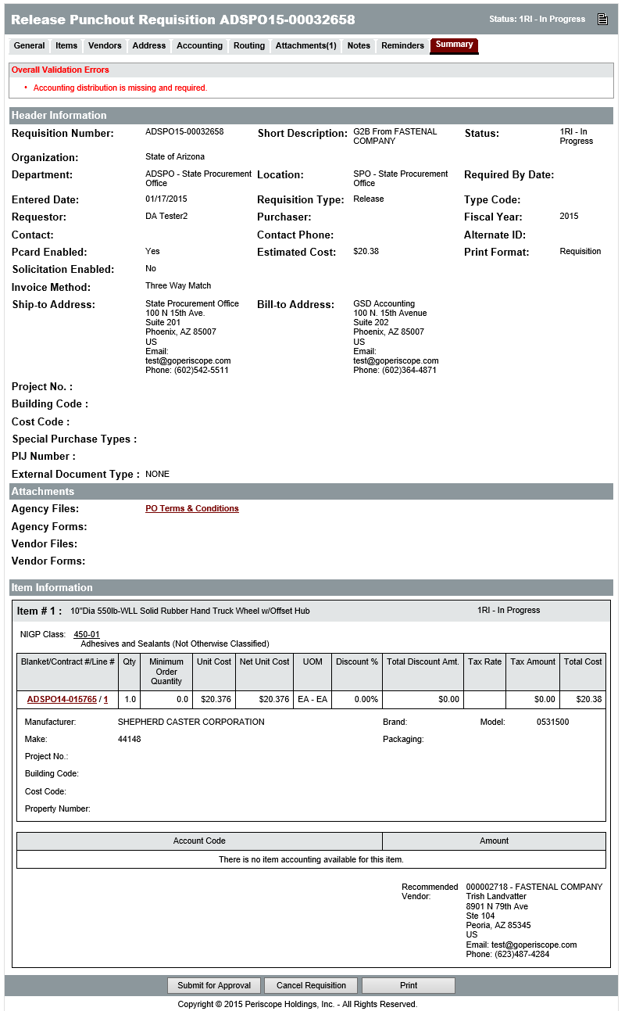
Review and Submit
Summary Tab
Verify method of payment
Submit for Approval
Cancel Requisition
Print
Final Approval
PO Ready to Send
i
Notes:
TIP: Before submitting the document for approval, users must verify the method of payment and make sure that the appropriate option is selected for P-Card Enabled for the Requisition.
Clicking Submit automatically creates/generates the Purchase Order document

Slide 18
AFIS Integration
ProcureAZ documents that are being paid with a P-Card are not integrated to AFIS due to the P-Card payment methodology.
Since many Punchout purchases are made using the PCard we are not including integration within this lesson.
The Contract Release Lesson will discuss the AFIS integration methodology for contract purchases.
If a Punchout purchase did not use a P-Card for payment, it would follow that same path.

Slide 19
Activity 3.1
Create a Punchout Requisition
Scenario
You need to request the purchase of batteries for your Department. The batteries are covered under a Master Blanket contract with access to a Punchout vendor website so you will create a Punchout Requisition for the Items and submit it for approval.
Notes:
Note: If the Requisition is submitted, the Trainer will need to process the disapproval of each submitted document before beginning the next activity.

Slide 20
Check the Status of a Punchout Requisition
Reqs Tab
By Document Status
Returned Status
Notes:
The status of a Requisition can be monitored at any point in the document lifecycle. The Home Page displays tabs for all document types accessible by the user profile.
The Reqs tab is used to view Requisitions saved in ProcureAZ and contains sub-tabs for each document status. Each tab name contains the number of documents displayed on that tab in parenthesis.

Slide 21
Correct Returned Requisition
Reopen Requisition
Change Accounting information
Cannot change Items
Cancel Requisition
Clone Requisition
Cannot clone Punchout
Must create new Punchout
Notes:
Only the Accounting information on the Punchout Requisition can be changed. If changes are required and allowed, on the Summary tab, click the Reopen Requisition button to change the status of the document to In Progress and enable document modification.
Items on a Punchout Requisition cannot be changed once they have been selected from the vendor’s website. If the Requisition Items are not correct, the Requisition document must be canceled and a new Requisition must be created.
Only the creator or a user with the Basic Purchaser role can cancel a Punchout Requisition.
TIP: Punchout Requisitions cannot be cloned. If a requisition needs to be created the user will have to start from scratch.

Slide 22
Activity 3.2
Check Requisition Status and Cancel a Returned Requisition
Scenario
You want to check on the status of the Requisition you submitted. The Requisition you created in the previous activity has been returned because the wrong tools were selected on the vendor’s website. You will cancel the returned Requisition.

Slide 23
Punchout Purchase Orders
Purchase Order Creation
Automatic upon final approval
Requestor must send to vendor
Summary tab
Vendor Notification Actions
Save & Continue

Slide 24
Cancel Punchout Purchase Order
Cannot cancel PO
Create cancellation Receipt
Notify vendor
Notes:
Note: There will not be a Punchout Purchase Order in the system for each student unless the training system is setup to allow processing and conversion from Requisition to Purchase Order.
NOTE: The State’s integration methodology excludes P-Card transactions. Please consult with your agency regarding their P-Card processing expectations in AFIS.

Slide 25
Summary
Created a Punchout Requisition
Checked the status of a Punchout Requisition and corrected/canceled a Returned Requisition
Reviewed the Punchout Purchase Order process

Slide 26
Check Your Progress
Punchout Requisitions are created to purchase Items _________.
a. Off Contract
b. On Contract via vendor website
c. On Contract via telephone
d. On Contract via catalog
Notes:
The correct answer is b. On Contract via vendor website.

Slide 27
Check Your Progress
After proceeding through the Check Out process, additional Items can still be added to a Punchout Requisition.
a. True
b. False
Notes:
The correct answer is b. False.

Slide 28
Check Your Progress
Orders can be paid for by _________.
a. Warrant
b. P-Card
c. Neither of the above
d. Both a and b
Notes:
The correct answer is d. Both a and b (Warrant and P-Card).

Slide 29
Check Your Progress
Punchout Purchase Orders are _________.
a. Created by the Requestor after Requisition approval
b. Created by the Buyer after Requisition approval
c. Created By clicking the Create PO button on an approved
Requisition
d. Automatically generated after Requistion Approval
Notes:
The correct answer is d. Automatically by the system.

