Slide 1
ProcureAZ
14 Master blanket Contracts

Slide 2
Objectives
Create a Master Blanket contract
Manage the communication of the contract with the vendor
Examine the Master Blanket completion and amendment processes

Slide 3
Master Blanket Overview
Term contract between vendor and the State of Arizona
No Shipping, Billing, or Accounting information
Not an order for goods or services
Does not encumber funds
Notes:
This points out the diff btwn Blanket and Open market since they look the same.

Slide 4
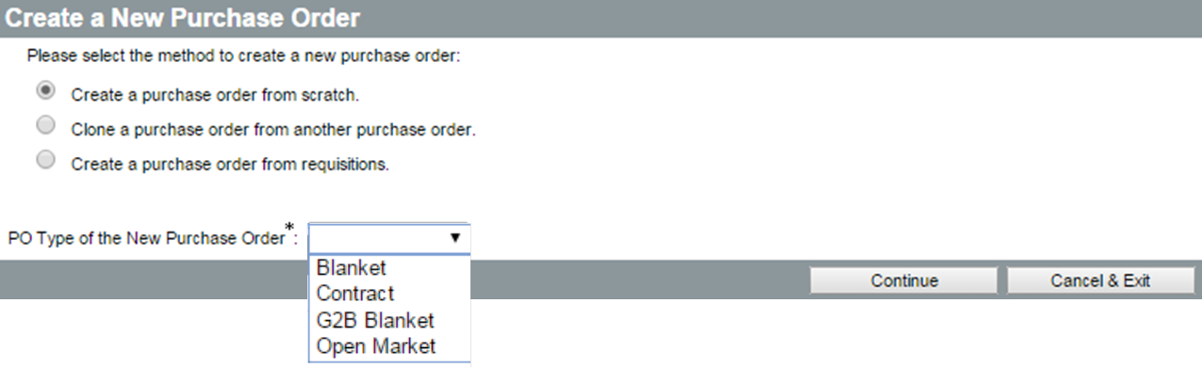
Create a Master Blanket PO
Convert a Requisition
Clone a PO or Requisition
New PO from scratch
Create from a Completed Bid
Notes:
TIP: Unless the creator of the Requisition conducted an RFQ, you will most likely need to conduct a solicitation before awarding a term contract by creating a Master Blanket PO.
IN SCREENSHOT
Option 1: create from scratch
Option 2: Clone from another PO
Option 3: Create a PO from requisitions
PO Type? Blanket, Open Market and G2B Blanket – WE DO NOT use CONTRACT

Slide 5
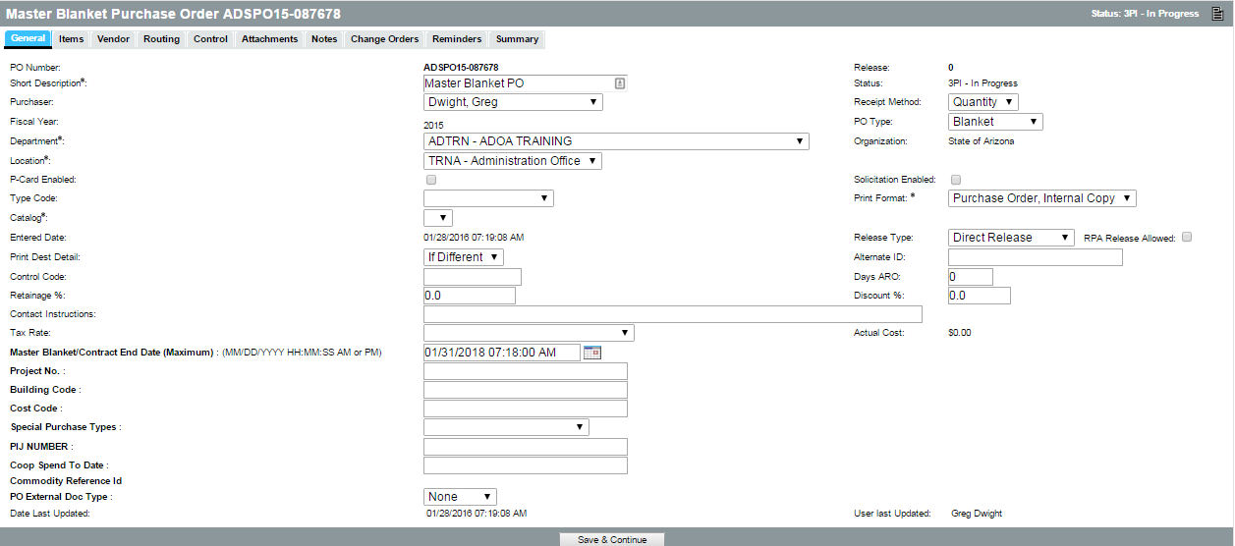
Complete a Master Blanket PO
General
Items
Vendor
Control
Attachments
Notes
Summary

Slide 6
General Tab
Short Description
Dept and Location
Receipt Method
Maximum Master Blanket/Contract End Date
P-Card Enabled?
Type Code
  Single-agency
  Multi-agency
  Statewide
Release Type
  Standard
  Direct
Notes:
Receipt Method – Select either Quantity or Dollar as the method that users will be able to received ordered contract items. Commodities must be received by quantity based on the integration with the State’s financial system, AFIS. Dollar is the preferred for service contracts, but if the services are ordered and billed at an hourly rate, the receipt method should be set to quantity. Receipt method may also be set at the line item level in the case of Master Blanket Contracts that have both commodity and service line items
In order for users to be able to use their P-Cards when making purchases against a Master Blanket Contract the P-Card Enable check box must be checked.
It is important to select the correct options on the General Tab to facilitate correct reporting.

Slide 7
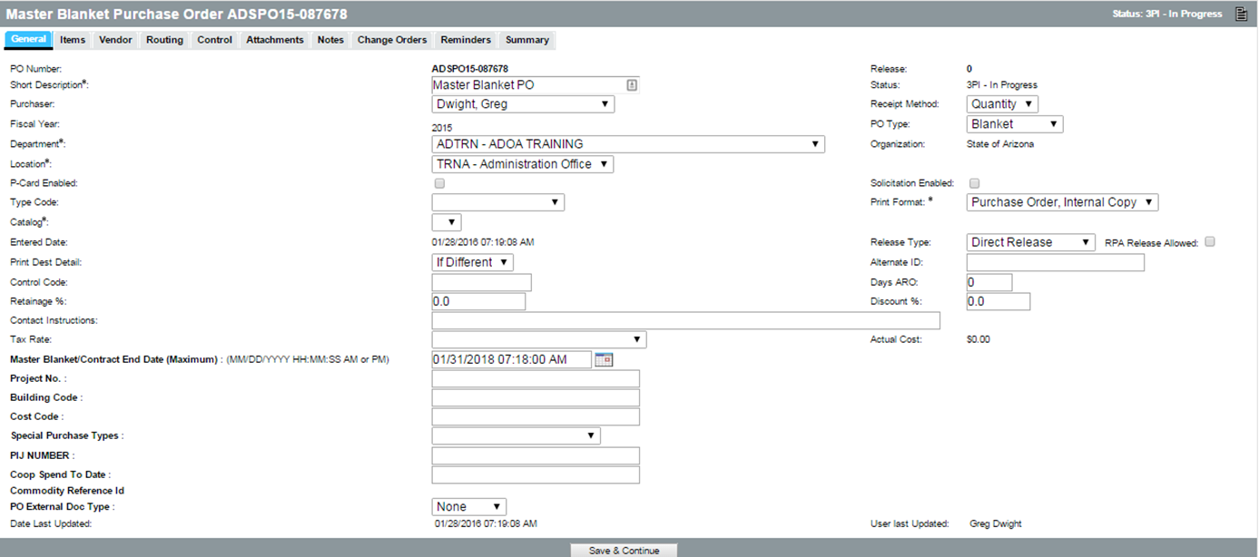
General Tab
Notes:
Short Description
Dept
Location
Catalogue

Slide 8
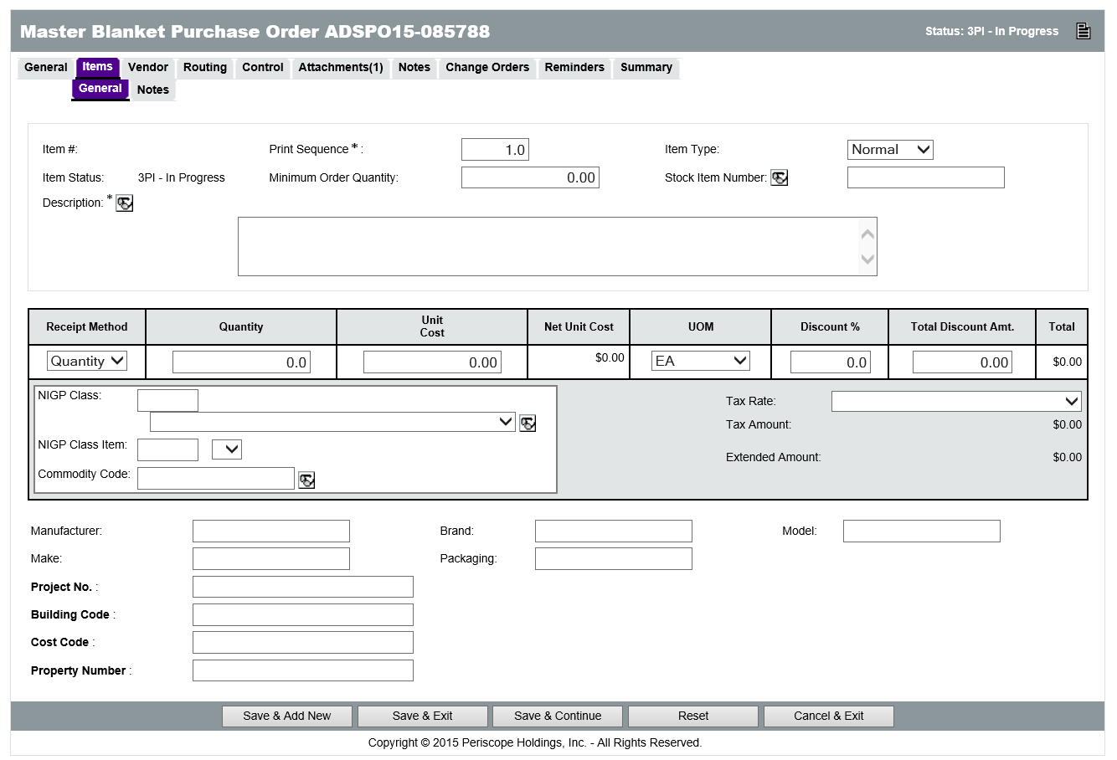
Items Tab
Create Items
  Minimum Order Quantity
  Quantity
  Unit Cost
  NIGP Class and Item
Notes:
TIP: It is recommended that either the Unit Cost or the Quantity field should be zero, depending on what has been locked in on the term contract.
WHEN CREATING LINE ITEM WITH ZERO COST/QTY, THESE ITEMS ACT AS PLACEHOLDERS FOR END USERS TO ENTER PRICE QUOTED OR FOUND ON ATTACHED PRICE SHEET
BE SURE WHEN ENTERING A DESCRIPTION IN THE ITEM THAT YOU CONSIDER THIS FROM THE POV OF AN END USER, EXAMPLE: NOT JUST CHAIR, BUT BLUE CHAIR or CHAIR, BLUE
In order for Accounts Payable staff to be able to pay for items and services ordered from Master Blanket Contracts in ProcureAZ, the items must have the correct type of NIGP code. Service items (like professional temporary services, consulting and monthly janitorial or pest control services) should have NIGP codes in the 900 series. This makes these items easier to pay through the integrated invoice process and assures that Fixed Asset Shells will not be created in error in AFIS. Goods (parts, batteries, pens, paper etc.) must have NIGP codes in the 005-800 series in order for the automated Fixed Asset Shell process to function properly in AFIS.
STATE DOES NOT USE THE COMMODITY CODE FIELD – ONLY NIGP CLASS AND CLASS ITEM

Slide 9
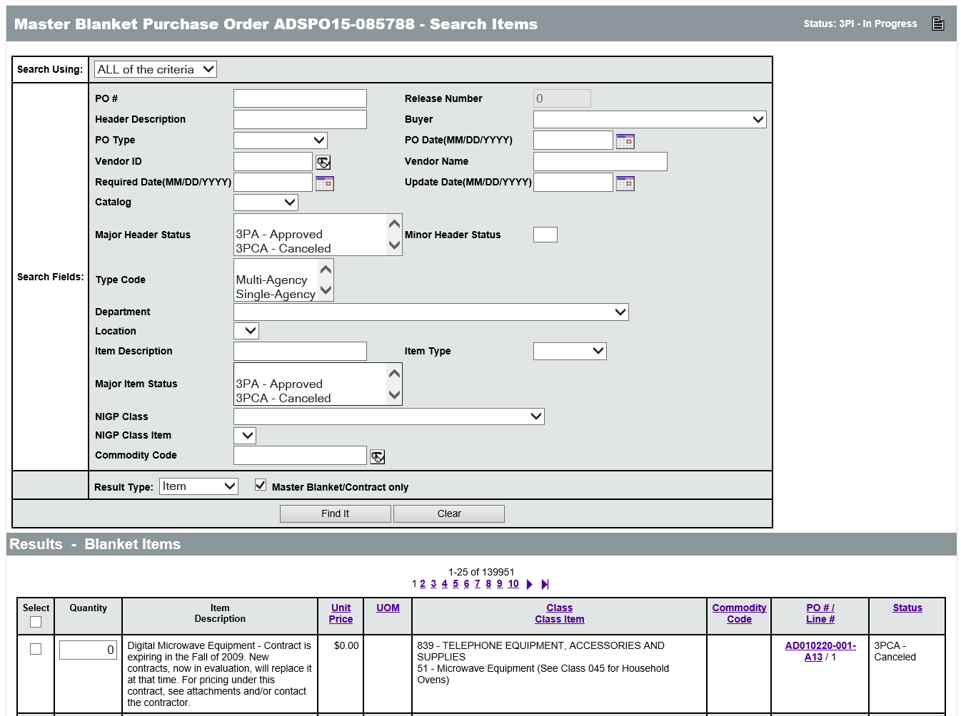
Items Tab
Search Items
Edit Items
Assign NIGP Codes to Master Blanket Items
Freight Charges
962-86
Special Items
Notes:
TIP: It is recommended that an equal quantity for freight and Items is entered to enable receipt of Items and freight in the same quantity.
For some contracts, a spreadsheet is attached that lists the items and prices available. When creating a requisition, Generic Line Items can be added to describe the different general categories of items available. These items are placeholders with no specified unit price. Users should refer to the attached spreadsheet that contains the items and pricing information. When a generic line item is selected, the customer must provide the price, quantity, and unit of measure for the specific item and add to the item description in order to specify exactly what is being purchased.
SPECIAL ITEMS ARE “PLACEHOLDERS” FOR END USER COST/QTY ENTRY WHEN ORDERING FROM A CONTRACT
In order for Accounts Payable staff to be able to pay for items and services ordered from Master Blanket Contracts in ProcureAZ, the items must have the correct type of NIGP code. Service items (like professional temporary services, consulting and monthly janitorial or pest control services) should have NIGP codes in the 900 series. This makes these items easier to pay through the integrated invoice process and assures that Fixed Asset Shells will not be created in error in AFIS. Goods (parts, batteries, pens, paper etc.) must have NIGP codes in the 005-800 series in order for the automated Fixed Asset Shell process to function properly in AFIS.
FREIGHT IS 962-86

Slide 10
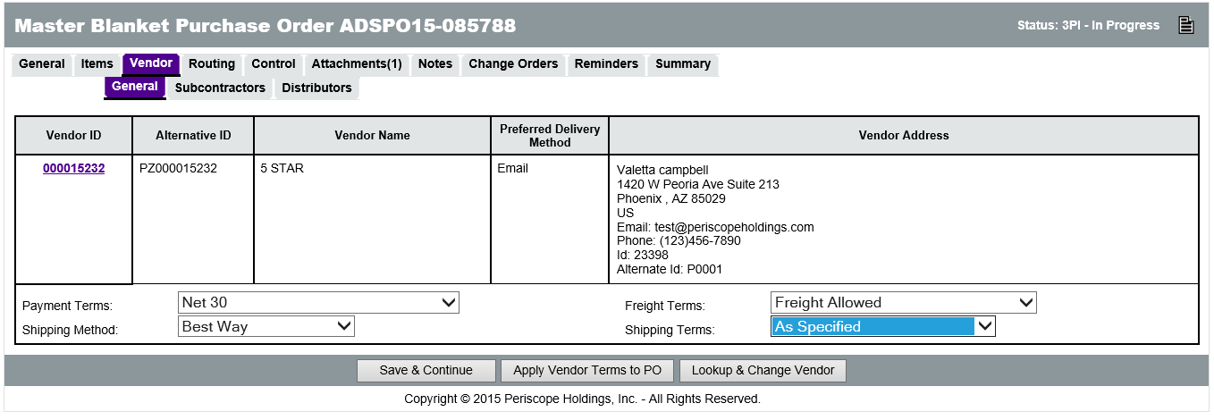
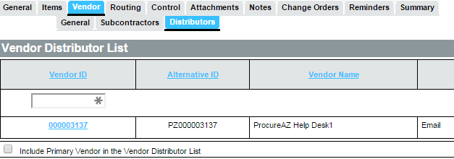
Vendor Tab
Prime contractor
  Payment terms
  Shipping terms
  Freight terms
Distributors
  Include Primary Vendor
  Lookup & Add Vendor
Notes:
TIP: There must always be at least one vendor with a Vendor Distributor Status of Active on the Distributors tab.
Amendments are not required to add distributors to a Master Blanket.

Slide 11
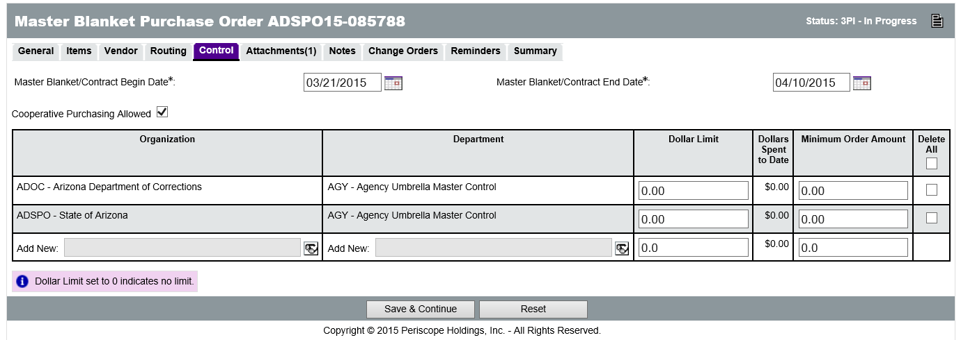
Control
Begin and End Dates
Single-Agency
Multi-Agency
Statewide
Dollar Limit
Minimum Order Amount
Notes:
Dollar Limit and Minimum Order Amount are generally used on Single Agency contracts, not on Statewide contracts.

Slide 12
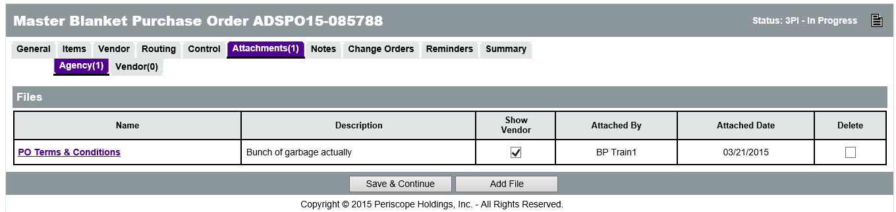
Attachments
Attaching Documents
Attachment Modification
Notes:
The official documentation related to the contract, including Terms and Conditions, Instructions, Specifications, etc. need to be attached to the PO document using the Attachments tab. Users need to complete these documents outside of ProcureAZ and attach them to the PO.
Any supporting documents for the PO must be scanned and attached to the document as specified by policy. It is important that any attached document name accurately describes the document. If the attached document should not be viewable by the vendor, the Show Vendor check box should be unchecked (it is checked by default).

Slide 13
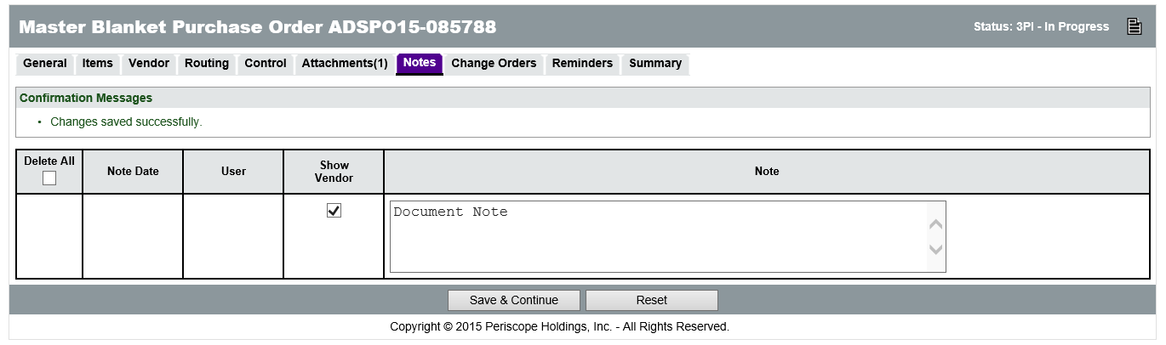
Notes
Add Notes
  Header
  Item
Notes:
TIP: Notes are not considered part of the procurement file. If the note is required to be part of the procurement file, it should be added as an attachment on the PO document.

Slide 14
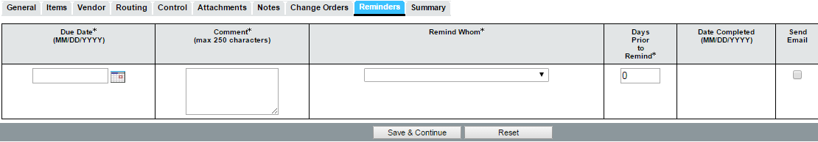
Reminders
Add Reminders
  Update Insurance Certificate
  Extensions
Notes:
TIP:

Slide 15
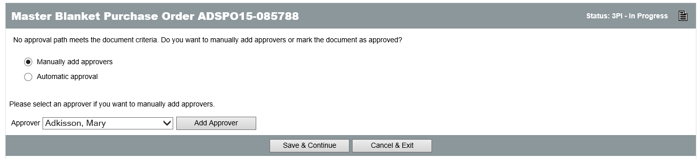
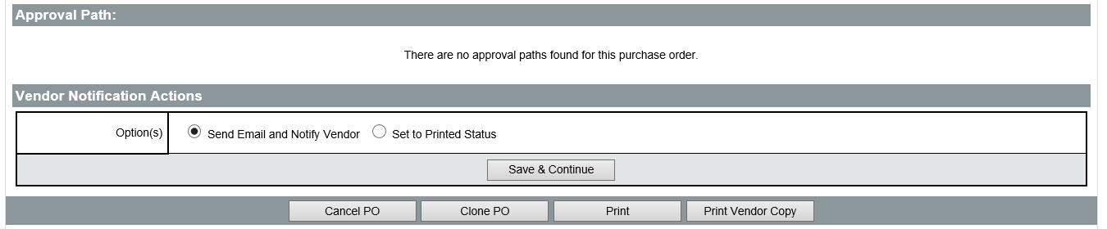
Submit for Approval
Printing the PO
Submit for Approval
Approval Process
  Disapproval
  Approval
Vendor Notification

Slide 16
Activity
Create a Master Blanket Purchase Order
Scenario
You have received a request to create a Master Blanket Purchase Order for a new purchasing contract.

Slide 17
Master Blanket Contract Management
Locate the Master Blanket PO
Amend the Master Blanket PO

Slide 18
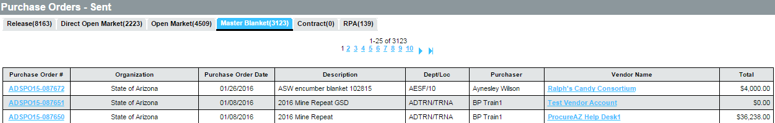
Locate a Master Blanket PO
Documents menu
  POs
  Sent

Slide 19
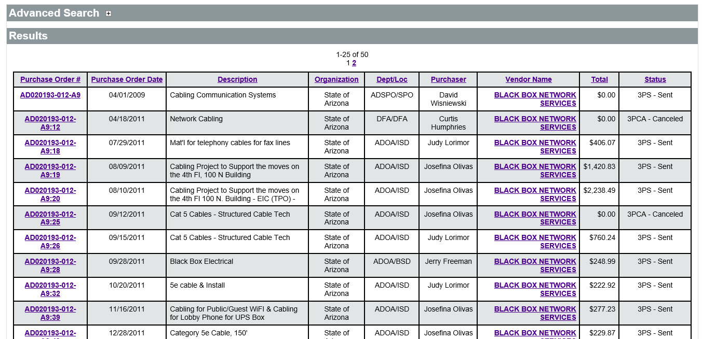
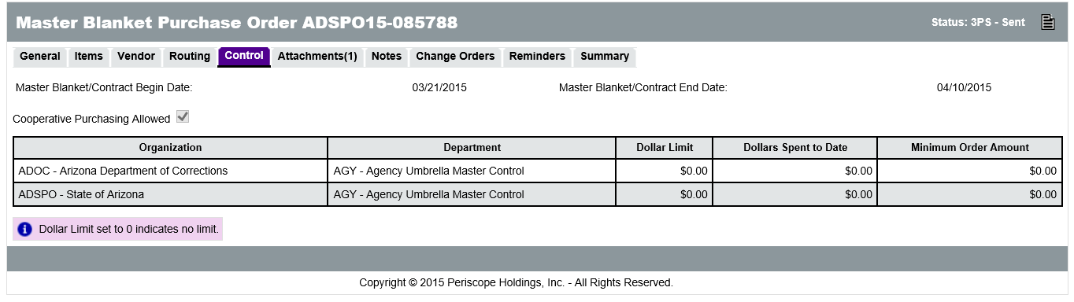
View Ordering Activity
Advanced Search
Notes:
NOTE: multi agency, however ADSPO user cannot see ADOC Releases

Slide 20
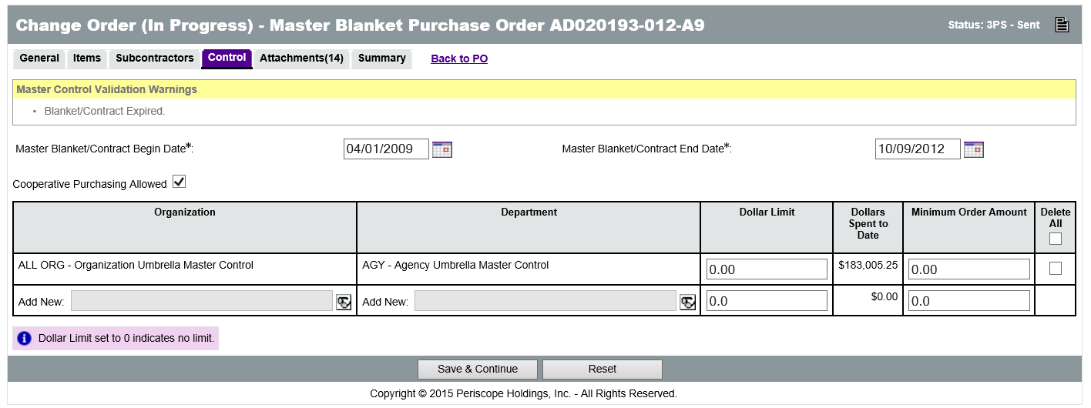
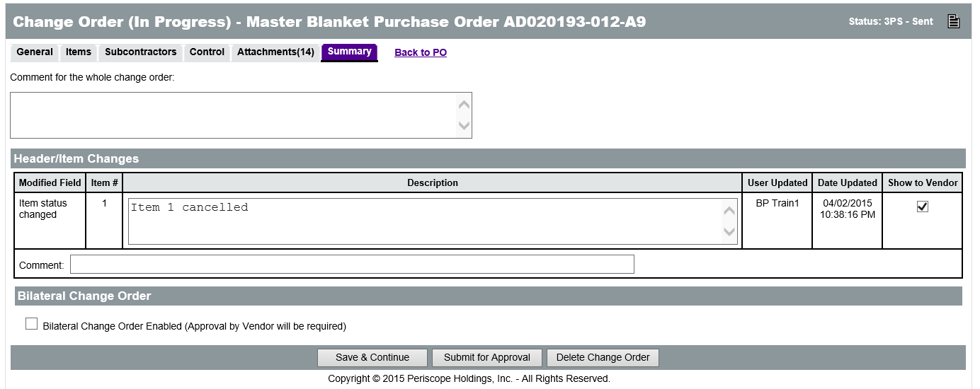
Amend a Master Blanket PO
Create a Change Order
  General tab
  Items
  Attachments
  Controls
    Contract Extension
Notes:
TIP: Do NOT change the Master Blanket/Contract Begin Date.

Slide 21
Complete a Change Order
Review and Submit
Apply Change Order
Vendor Acknowledgement

Slide 22
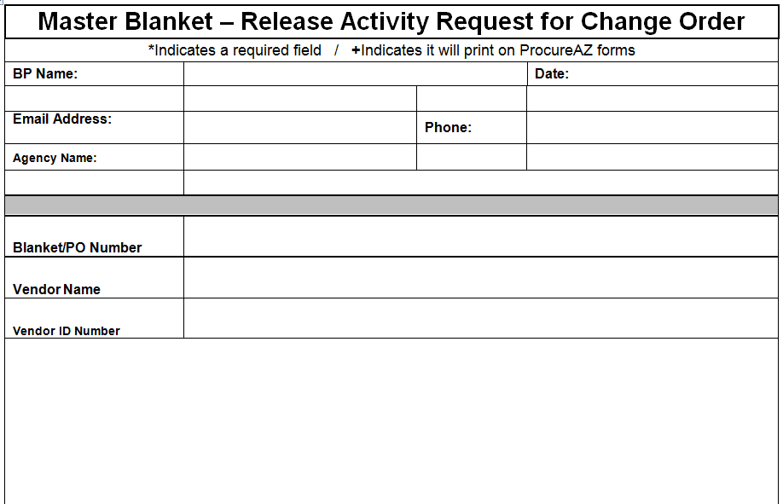
Change Orders to Line Items
Request Activity Report

Slide 23
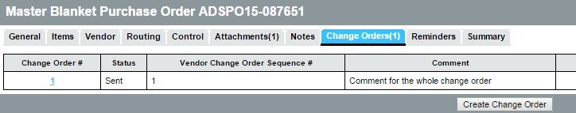
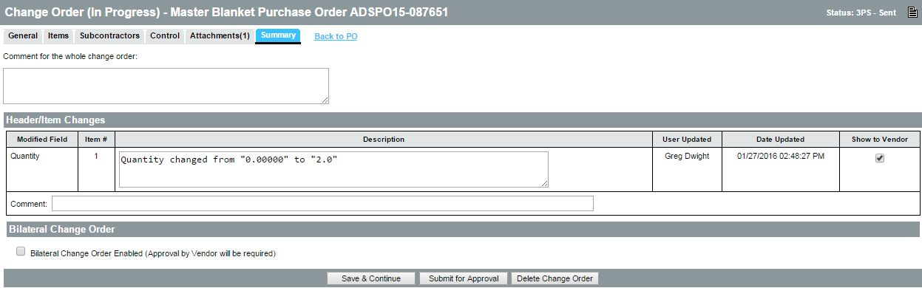
Create & Edit Change Order
Notes:
Show to Vendor - Comment for Whole CO

Slide 24
Activity
Manage a Master Blanket Purchase Order
Scenario
You have received a request to review and amend a Master Blanket Purchase Order for an existing purchasing contract.

Slide 25
Summary
Created a Master Blanket contract
Managed the communication of the contract with the vendor
Reviewed the Master Blanket completion and amendment processes

Slide 26
Check Your Progress
Master Blanket Purchase Orders can be created _________.
a. By cloning an existing document
b. From a Bid award
c. From scratch
d. All of the above
Notes:
The correct answer is d. All of the above

Slide 27
Check Your Progress
Freight is always included automatically in the pricing of commodities on a contract.
a. True
b. False
Notes:
The correct answer is b. False

Slide 28
Check Your Progress
Multiple vendors can be added as distributors for the Blanket contract.
a. True
b. False
Notes:
The correct answer is a. True.

Slide 29
Check Your Progress
What types of controls may be setup on a Blanket contract?
a. Active period
b. Departments that can order
c. Spending limits
d. All of the above
Notes:
The correct answer is d. All of the above

Slide 30
Check Your Progress
What page is used to view all of the ordering activity against a Blanket PO?
a. Documents > POs > Sent
b. Quick Find
c. Advanced Search
d. None of the above
Notes:
The correct answer is c. Advanced Search

Slide 31
Check Your Progress
The following can all be changed on a Blanket PO Change Order except _______.
a. Vendor information
b. Item information
c. Contract end date
d. Spending limits
Notes:
The correct answer is a. Vendor information

