Slide 1
ProcureAZ
8 Change Orders

Slide 2
Objectives
Review the methods available for locating Purchase Orders
Examine the process of creating Change Orders for a variety of scenarios
Identify the submission, approval, and application process for Change Orders
Notes:
Overview
A Change Order is a request to modify a Purchase Order. The guidelines that determine what can be changed on a Purchase Order are based on the type and status of the Purchase Order, as well as the Receipts and Invoices that are entered against the Purchase Order. A Change Order entered on an Invoice is automatically applied to the referenced Purchase Order. In this lesson, users will learn how to locate Purchase Order documents and to create, submit, and apply Change Orders to them.

Slide 3
Locate a Purchase Order
Home Page
Reqs tab
Gone to PO
Requisition Summary tab
PO Number link
Advanced Search
Purchase Orders
Enter search criteria
Find It
Purchase Order document number
Notes:
TIP: If there is no PO number listed for an Item, the Requisition has not yet been converted into a PO.

Slide 4
Create a PO Change Order
Changes allowed depend on:
PO Header Status
PO Item Receipt Status
Invoice Status
Change Order already in progress
Types of changes
Add a New PO Line Item
Change Accounting
Add Attachments
Direct/Open Market Only
Change Item Pricing, Quantity, Unit of Measure
Change Item Receipt Method
NOTE: No Change Orders of any kind are allowed in ProcureAZ on Maximo documents
Notes:
Once the Purchase Order has been opened, the Change Orders tab will display any existing Change Orders for the PO. There can only be one Change Order in progress at any given time. If there is already a Change Order in progress, and the user is authorized to see it, the View Change Order button will open the Change Order to the Summary tab. If there are no Change Orders in progress, a Create Change Order button will be displayed instead. Clicking the Create Change Order button will open a new Change Order to the Items tab.
TIP: If a quantity of Items is canceled during the Receiving process, a Change Order is automatically created that cancels that amount of Items on the PO.
TIP: Do not attempt to change the Receipt Method on an Open Market PO after receiving Items. This will cause critical errors to occur on the document.
TIP: Only one change order can be in process at a time.

Slide 5
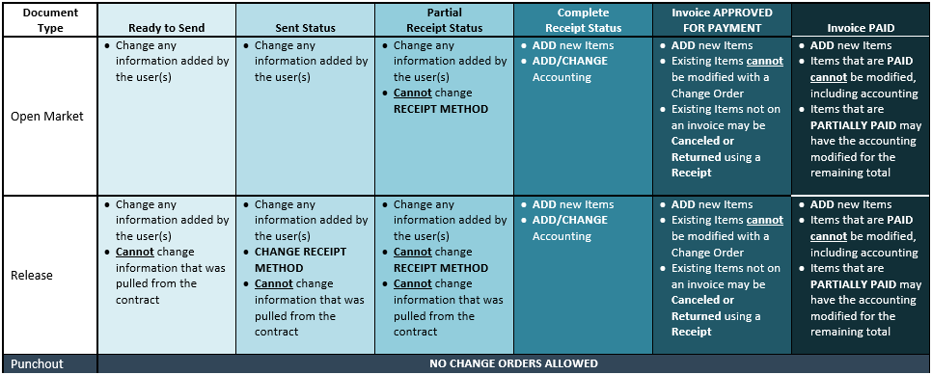
Change Order Matrix
Notes:
TIP: The best practice for adding items is to create a new line item rather than edit the original.

Slide 6
Change Order Approval and Application
Summary Tab
Comments
Description
Bilateral Change Order
Submit for Approval
Approval Path
Final Approval
Apply Change Order
Delete Change Order
Notes:
TIP: WARNING: Header Level comments are shown to the vendor.
Once the Change Order is complete, it must be submitted and approved before the changes can be applied to the Purchase Order for which it was created. The Summary tab of the Change Order displays the modifications that have been made to the Header/Item levels and the Item accounting information.
Bilateral Change Order
The Bilateral Change Order Enabled check box allows users to require the approval of the vendor before the Change Order can be applied to the Purchase Order. In order for a Change Order to be marked as a Bilateral Change Order, at least one change must be marked as Show to Vendor. If the Bilateral Change Order option is checked, users can select the vendor users from a list on the approval path screen as the final approvers.
Apply Change Order
At the bottom of the Summary tab, the Apply Change Order button is used to update the Purchase Order with the changes. The Purchase Order will be displayed along with a pop up message dialog box when the Purchase Order data has been processed. When the Summary tab has refreshed, it will display all of the information on the updated Purchase Order.

Slide 7
Activity 8.1
Create a Change Order
Scenario
You created an Open Market Purchase Order from a Requisition for a fishing boat and one oar. You need an additional oar and a case for the oars. You will locate the Purchase Order and create a Change Order to update the PO with the additional oar. Then you will submit the Change Order for approval and apply the changes to the Purchase Order.
Notes:
After Step G:
Note: The instructor should now pause to make sure everyone has completed the activity up to this point. The next step requires that all of the Change Orders be approved by the instructor.

Slide 8
Summary
Reviewed the methods available for locating Purchase Orders
Examined the process of creating Change Orders for a variety of scenarios
Identified the submission, approval, and application process for Change Orders

Slide 9
Check Your Progress
There can be more than one Change Order in progress for a single Purchase Order.
a. True
b. False
Notes:
The correct answer is b. False.

Slide 10
Check Your Progress
Where can a user find a link to a Purchase Order if one is not listed on the Summary tab of the Requisition?
a. Advanced Search
b. The Documents menu
c. The Notifications tab
d. None of the above
Notes:
The correct answer is d. None of the above. (Because the Req has not been converted to a PO)

Slide 11
Check Your Progress
Change Orders can be manually created on a Purchase Order and are automatically created by processing a cancellation of Items on a Receipt.
a. True
b. False
Notes:
The correct answer is a. True.

Slide 12
Check Your Progress
The following information can be changed on a Release Purchase Order in Sent status:
a. The Item accounting information
b. The Item quantity
c. The Item cost
d. Both a and b
Notes:
The correct answer is d. Both a and b. (Not Item Cost, Unit of Measure, or Receipt Method)

Slide 13
Check Your Progress
Which of the following is not a factor that affects the types of changes that can be processed through a Change Order?
a. Item partial receipt status
b. Invoice paid status
c. Item receipt method
d. Invoice approved status
Notes:
The correct answer is c. Item receipt method.

Slide 14
Check Your Progress
Approving a Change Order updates the Purchase Order.
a. True
b. False
Notes:
The correct answer is b. False. “Applying” the change order is what updates the Purchase Order.

